Slide 1
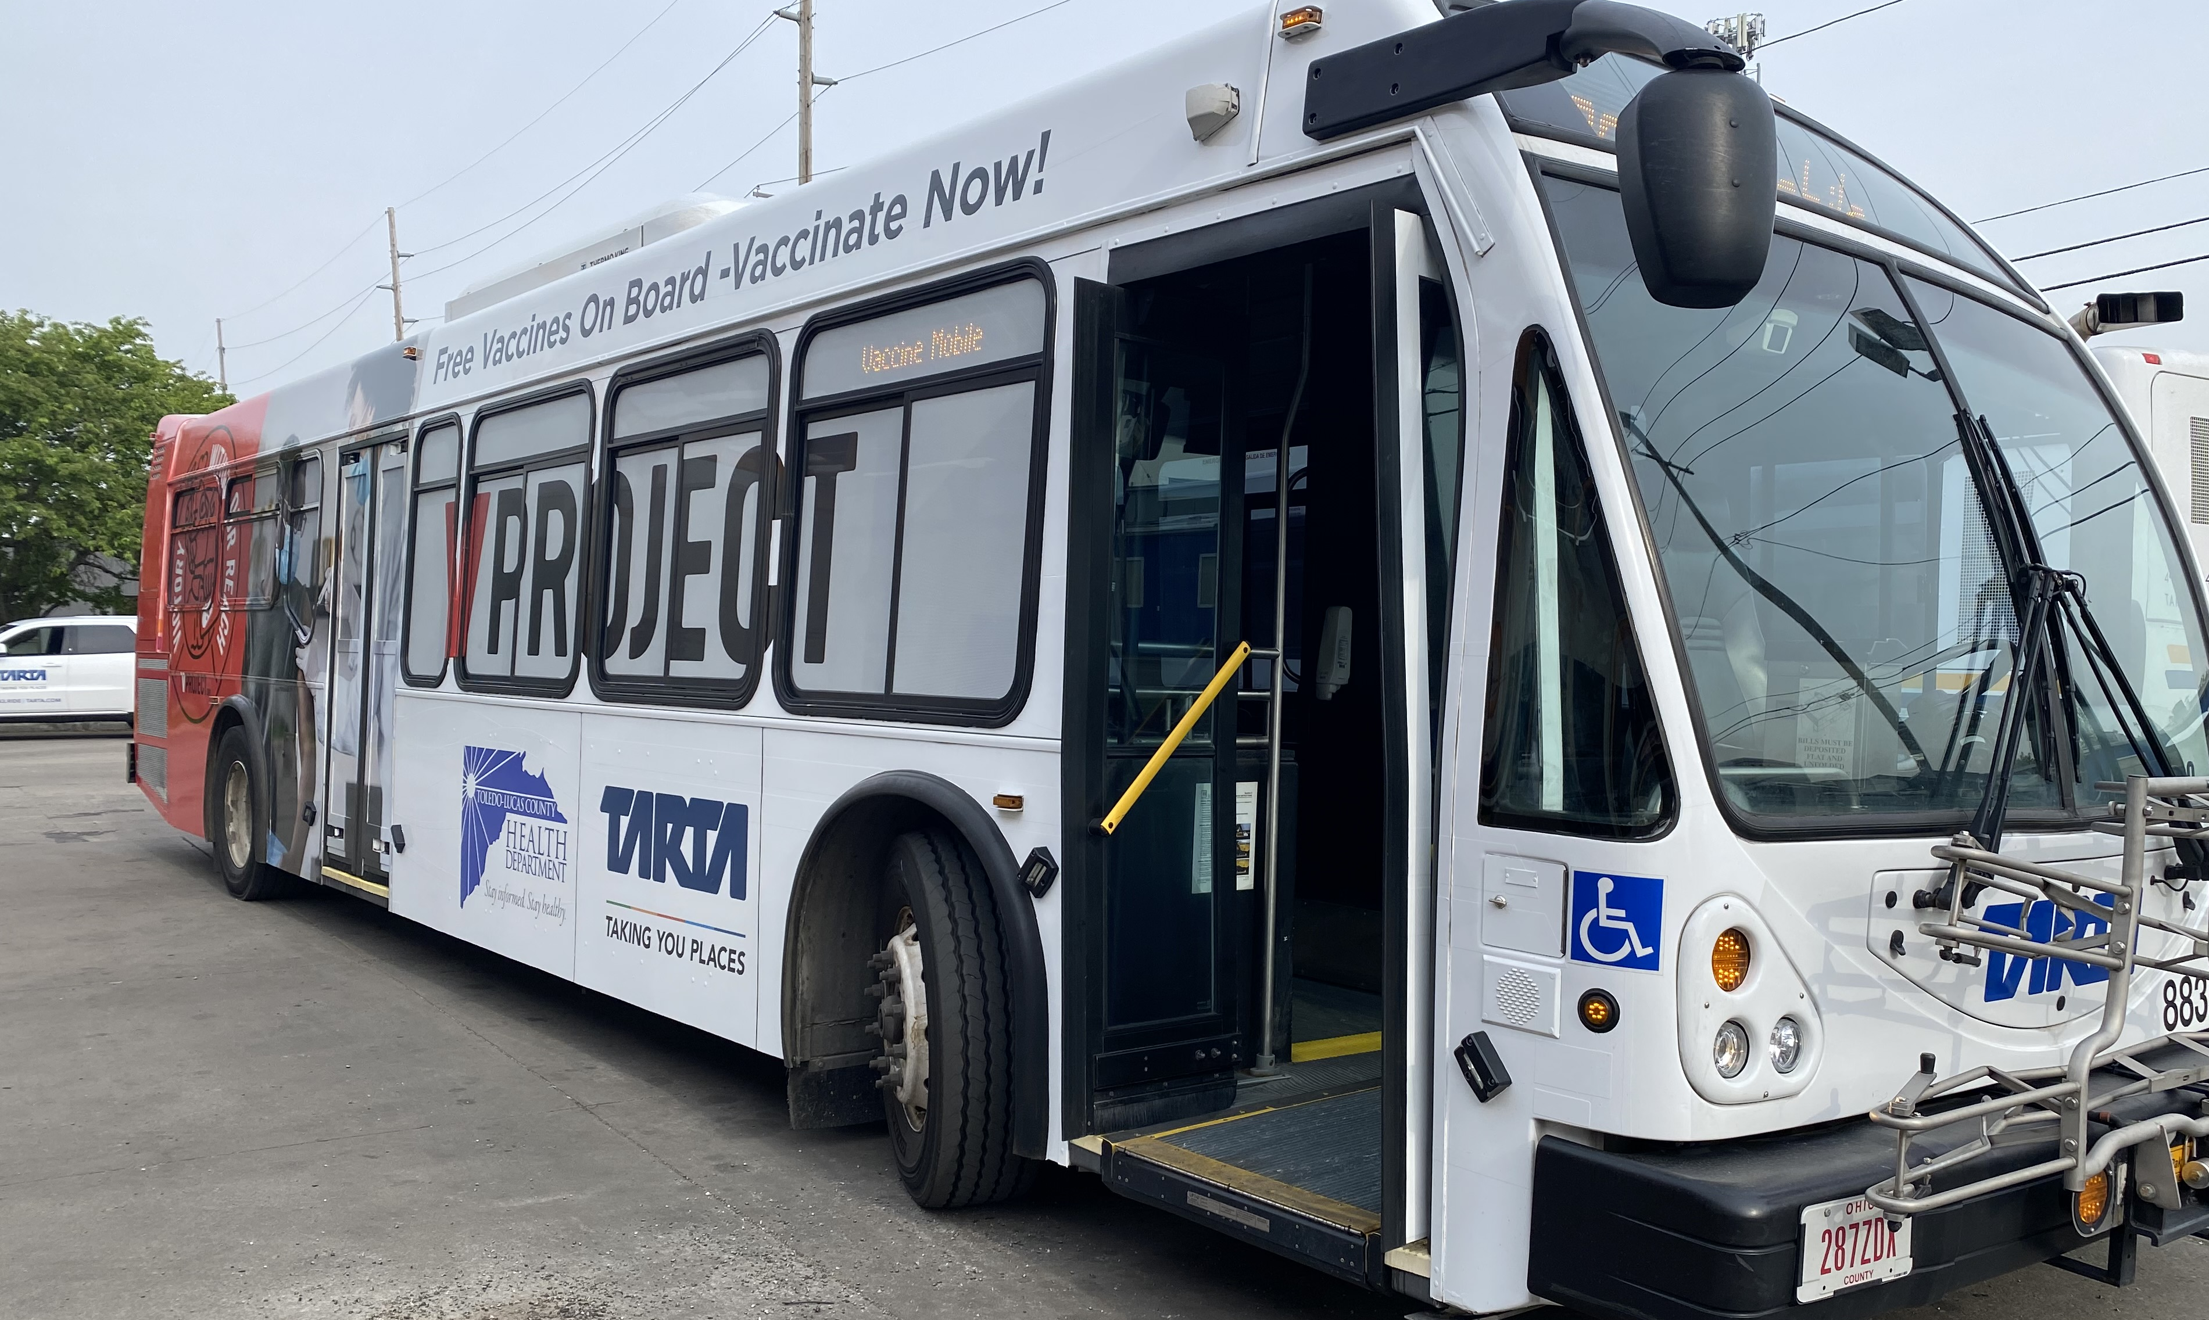
WWW.TESLACREATIVEITY.COM

Slide 2
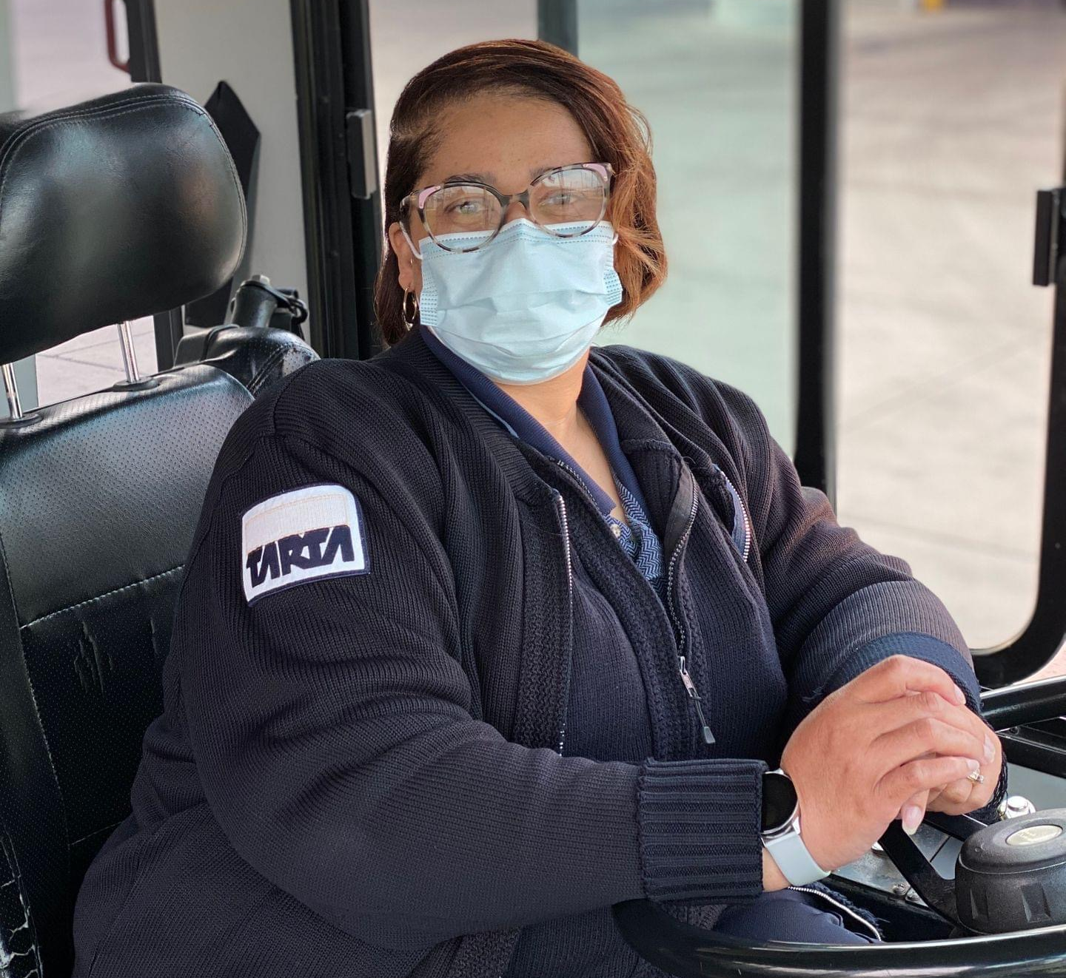
OUR PROPOSAL
Expand service to entire County
Eliminate 2.5 mill property taxes; replace with 0.5% sales tax
Allocate monies from sales tax to fund TARTA operations and capital backlog
Allocate monies to fund community infrastructure projects annually:
$300,000 City of Toledo
$90,000 For Each Other TARTA Jurisdiction
votefortarta.com

Slide 3
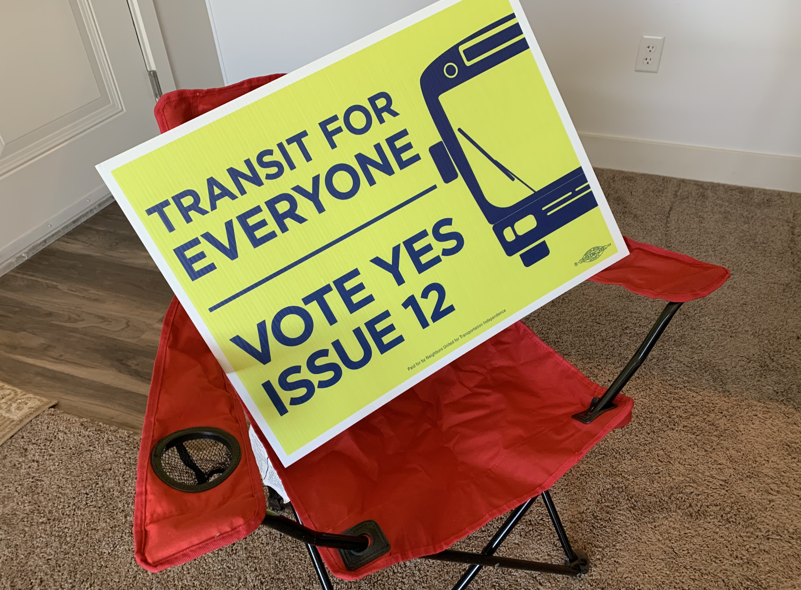
SAVING TARTA
votefortarta.com

Slide 4
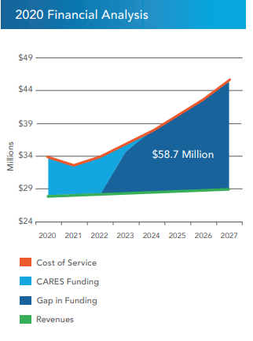
FINANCIAL REALITY- LOOMING DEFICIT
MARY
ELIZABETH
Future Budgeting Solutions
Budget Federal Funds for Capital Projects - $6.5 million
Budget Local Match for Capital Projects - $1.625 million
Live within Economic Model Defined by Community Investment
Right Size Workforce and Fleet
Departmental Reorganizations
Toledo Public School Contract Ends June 2021
votefortarta.com

Slide 5
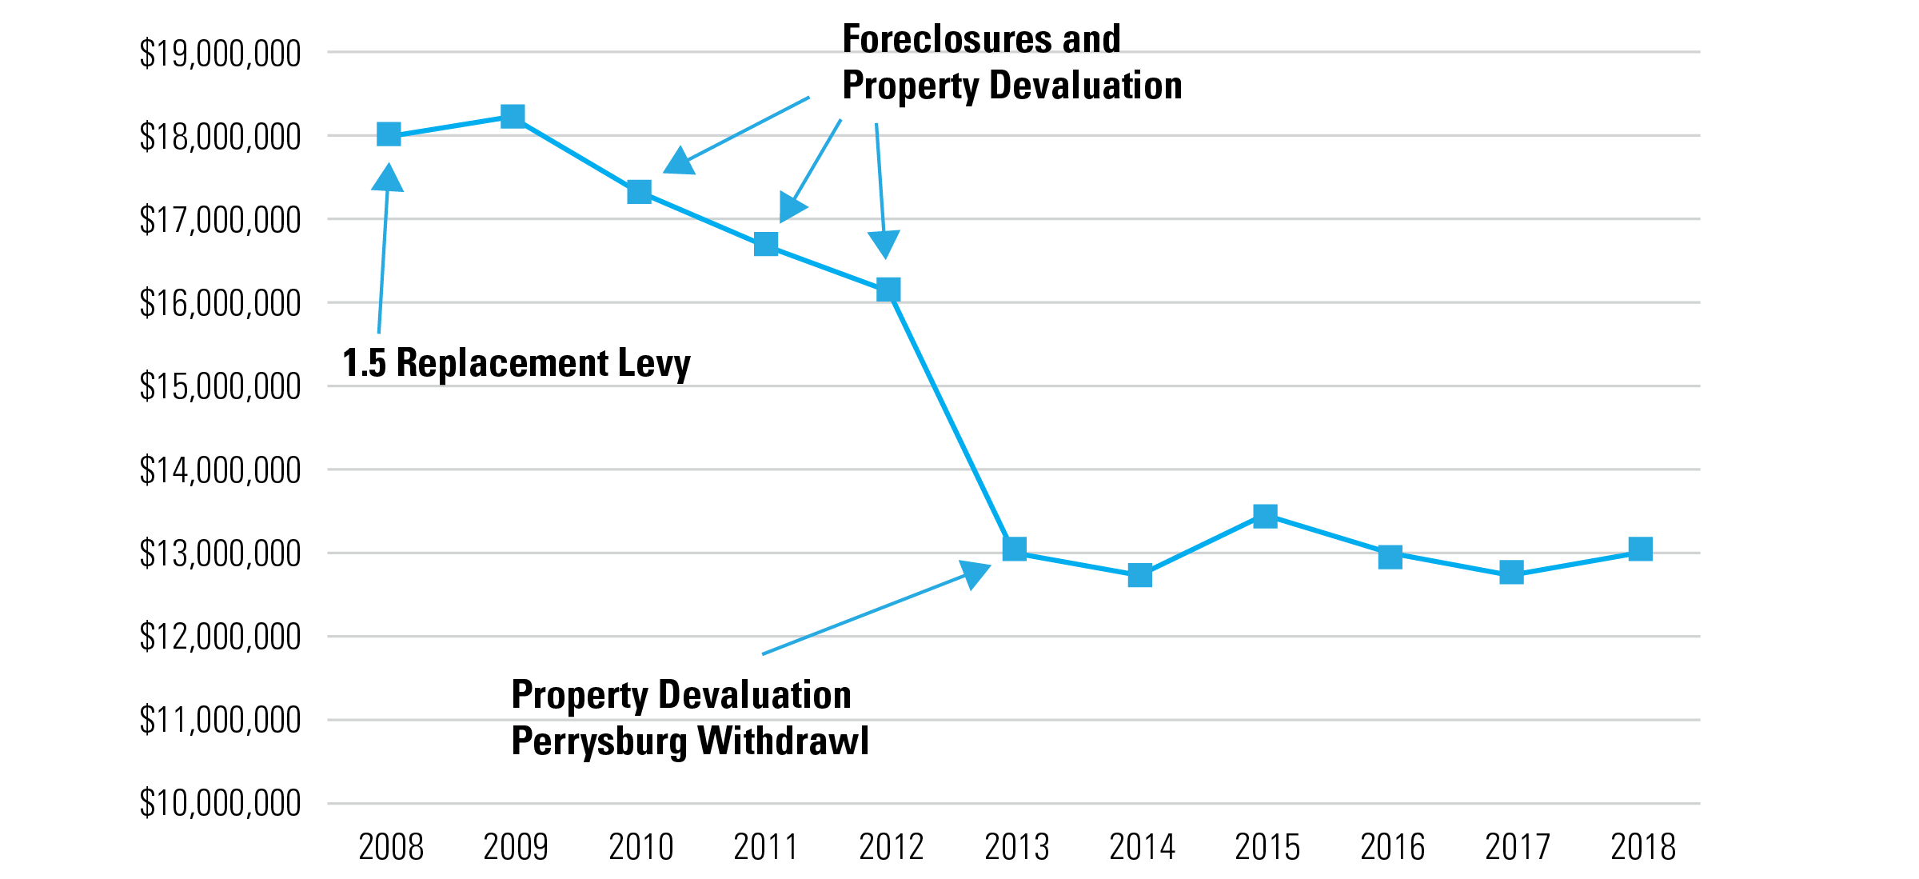
PROPERTY TAX REVENUE DECLINE HISTORY
votefortarta.com

Slide 6
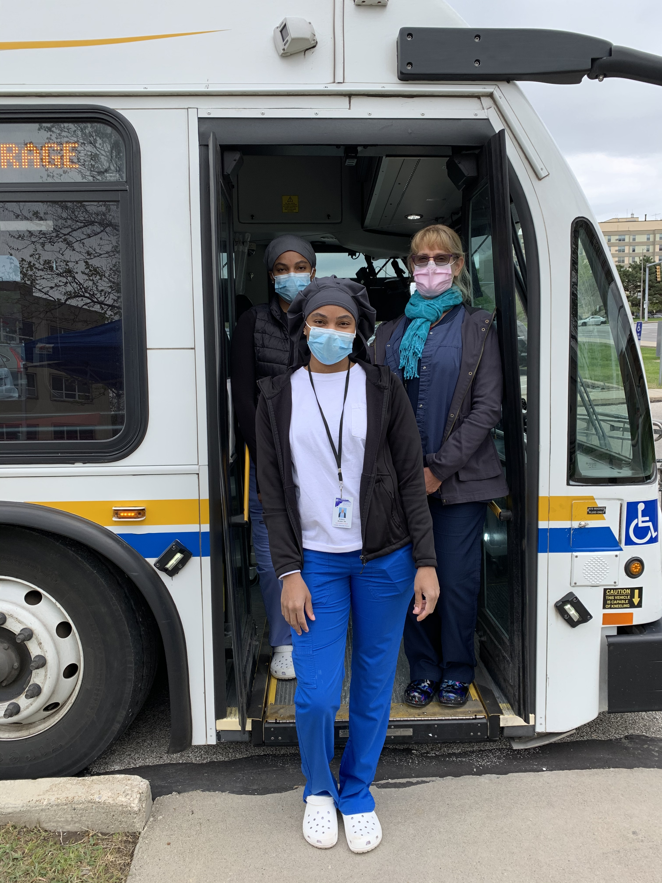
RESULTS OF OUR DEFICIT
Oldest bus fleet in Ohio
Buy used vehicles from other cities
No significant upgrades to garage and technology in decades
Capital funds spent on operating, not long-term investment
Limited service and routes
Wage and benefits stagnation
Lack of customer amenities
Poor brand and image
votefortarta.com

Slide 7
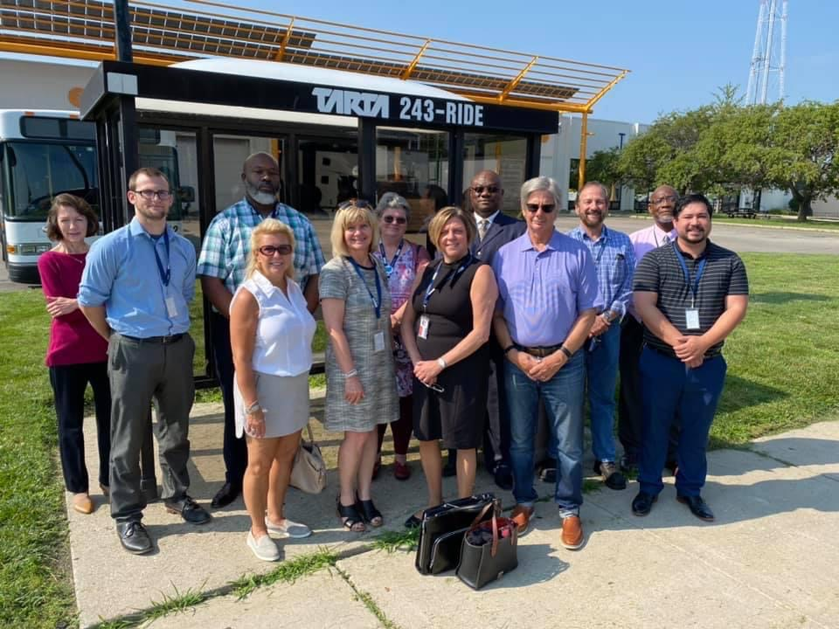
NEVER DOUBT
That a small group of thoughtful, committed citizens can change the world; indeed, it’s the only thing that ever has.
- Margaret Mead
votefortarta.com
Notes:
remove

Slide 8
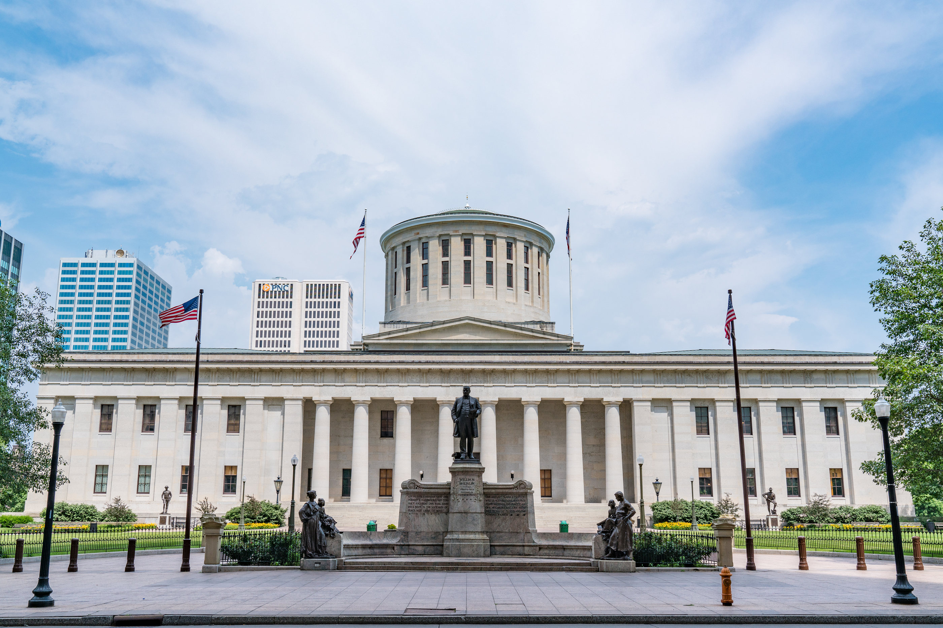
Time for a New Strategy
HALF-TIME: MAKING THE RULES FAIR
MARY
ELIZABETH
Future Budgeting Solutions
Temporarily Changed State Law from Unanimous to Majority
Hired a State Lobbying Firm
Cultivated Broad Political Support from Toledo Area Leaders
Secured Governor’s Support for TARTA Language in Biennial Transportation Bill
votefortarta.com

Slide 9
REGION IN A
RENAISSANCE
Toledo #1 in Business Investment 200k-1m population - Site Selection Magazine
#1 Park System in the United States $22m Downtown Glass City Riverwalk Metropark Underway
#1 Zoo in the United States
Toledo Jeep Fest – 65,000 Attendees
$2b in Transportation Investment
New Downtown Glass City Center, Hotels and Apartments
votefortarta.com

Slide 10
HOW TRANSIT BUILDS STRONG COMMUNITIES
Funding transit is an Investment in our economy
Marketing a Region
Toledo Regional Chamber of Commerce support
Economic Development
Workforce Development
Access to Jobs
Attracts Business
Many new businesses are outside of TARTA service area
votefortarta.com

Slide 11
HOW TRANSIT BUILDS STRONG COMMUNITIES
Funding transit is an Investment in our quality of life
Access to healthcare
Promotes aging-in-place
Maintain independence for seniors
Expand TARPS
votefortarta.com

Slide 12
TARTA OF THE FUTURE
Economic Benefits
Service Expansion
Bus Rapid Transit (BRT)
Diversify
Services
Getting There
System Redesign
Attract and grow talent and businesses
Expand Access to Jobs
Economic Development
Frequency
Sunday Service
Early Morning
Late Night
Major Events
Major Employers
Micro-transit
Community Needs
Diversified Fleet
Fuel Efficiency
Business Driven
High Frequency Corridors
Pre-board Fare
Transit Oriented Development
Attracts New Businesses
Faster Trips
Destination Focused
Cross-town Service Model
Technology
Rebranding
Multi-Modal Mobility Hubs
Rail, Bike, Ped Connections
Wayfinding
Connect to Jobs
votefortarta.com

Slide 13
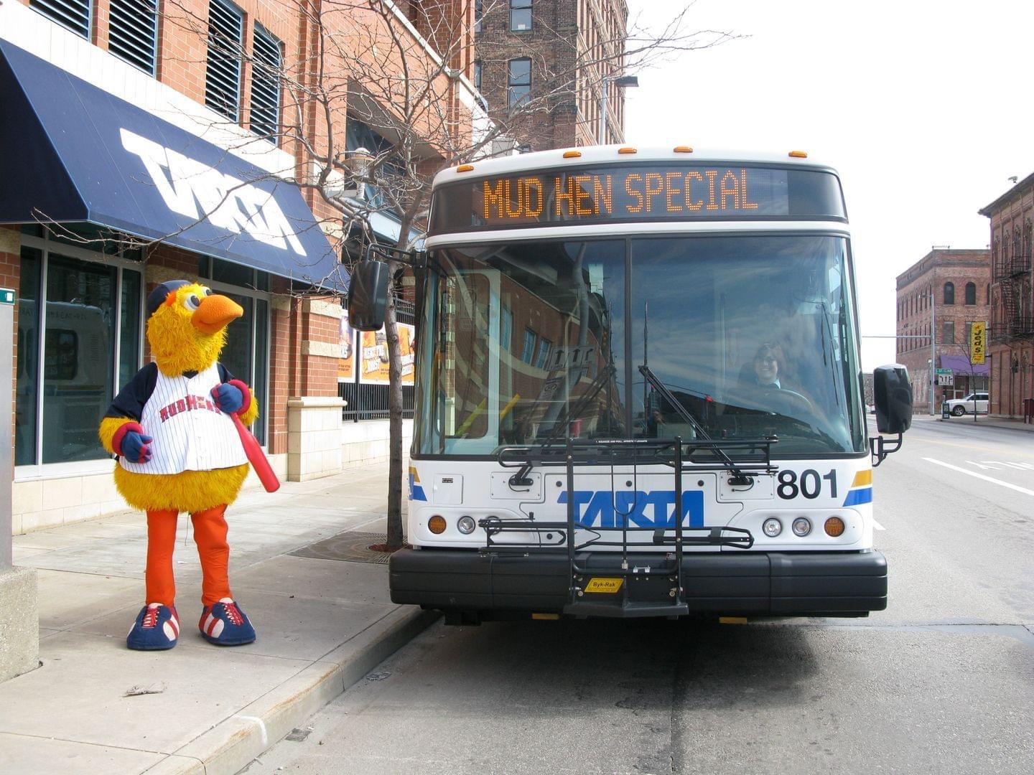
TRANSFORMING
TARTA
New Leadership Team – 175 years of transit experience
Adopted Authority’s First Strategic Plan
Kicked-Off System Redesign and New Vehicles
Refreshed Brand and Marketing
Successfully Restored Hours of Service During the Pandemic
votefortarta.com

Slide 14
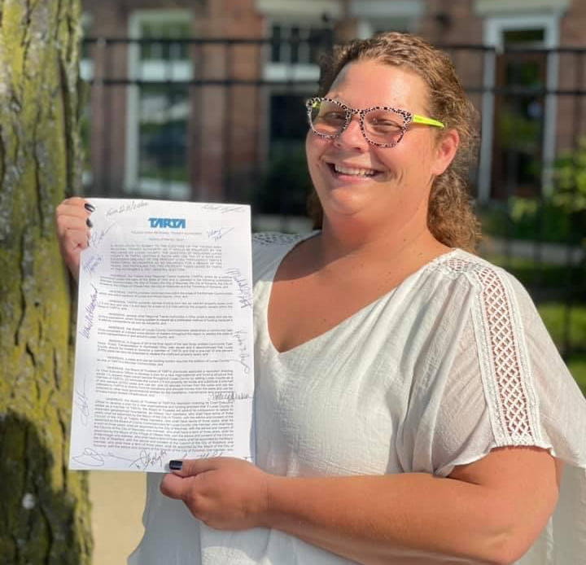
TEAMWORK MAKES THE DREAM WORK
110% Partnership with Labor
Business Endorsement and Statehouse Advocacy Partner
Disability and Senior Groups Funded Ads and Mailers
TARTA Board Members = Campaign Champions
Repaired Key Community Relationships
votefortarta.com

Slide 15
Editorial: ‘No’ on TARTA sales tax
11/1/2021
THE BLADE EDITORIAL BOARD
The answer to TARTA’s woes has little to do with the funding mechanism and everything to do with a lack of creative ideas for the future of public transit in Toledo and the suburban communities surrounding the city.
No funding system can fix a flailing and failing transportation agency.
The Toledo Area Regional Transit Authority, voted to include Lucas County as a member earlier this year, now asks voters to approve a 0.5 percent sales tax for Lucas County and Rossford to replace two property levies that total 2.5 mills and generate about $13 million a year in revenue.
The Power of the Media?
votefortarta.com
Notes:
remove

Slide 16
Voters pass TARTA measure with new funding structure
11/2/2021
BY DAVID PATCH / THE BLADE
After a half-century of public transportation subsidized by property taxes, metro Toledo’s bus system apparently will switch to a sales tax in the spring.
With 100 percent of Lucas County precincts reporting, preliminary results showed the Toledo Area Regional Transit Authority proposal to collect a half-percent sales tax throughout the county carrying 54.9 percent of ballots cast, while in Rossford, preliminary final results showed almost exactly 60 percent of voters — 749 to 500 — supporting it.
The Power of an Effective Campaign
votefortarta.com
Notes:
remove

Slide 17
CONCLUSION
Support TARTA Sales Tax
Create Jobs
Promote Independence
Support Seniors
Repeal Existing Property Tax

