Slide 1
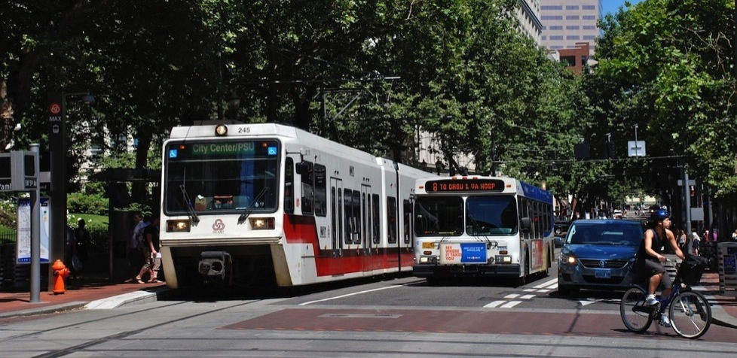
David Bragdon,
Executive Director
A foundation improving public transit through applied research, advocacy, events and grant-making.

Slide 2
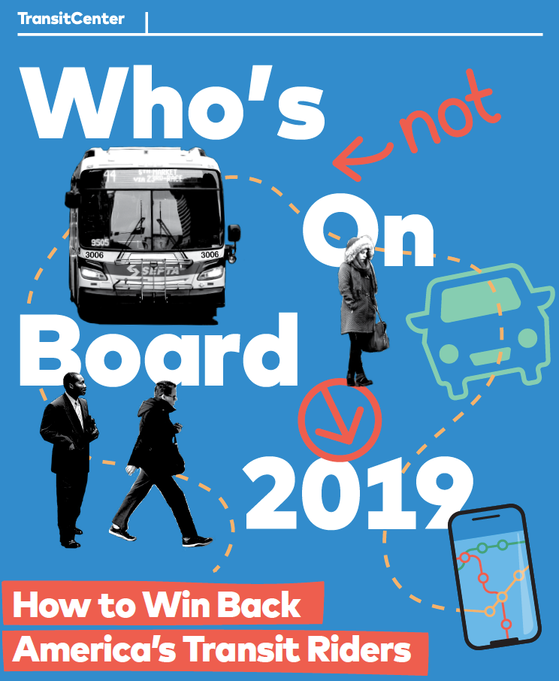
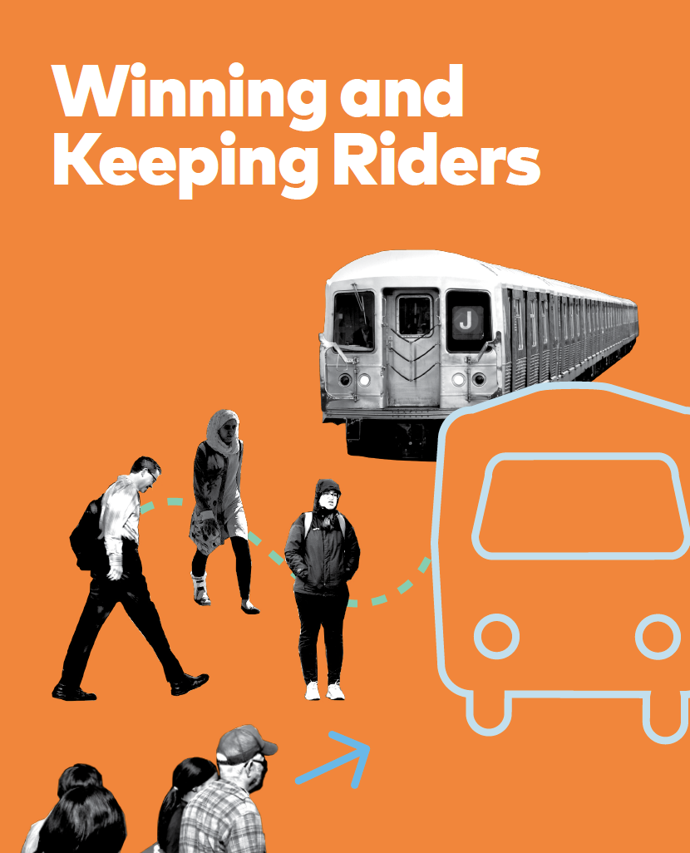
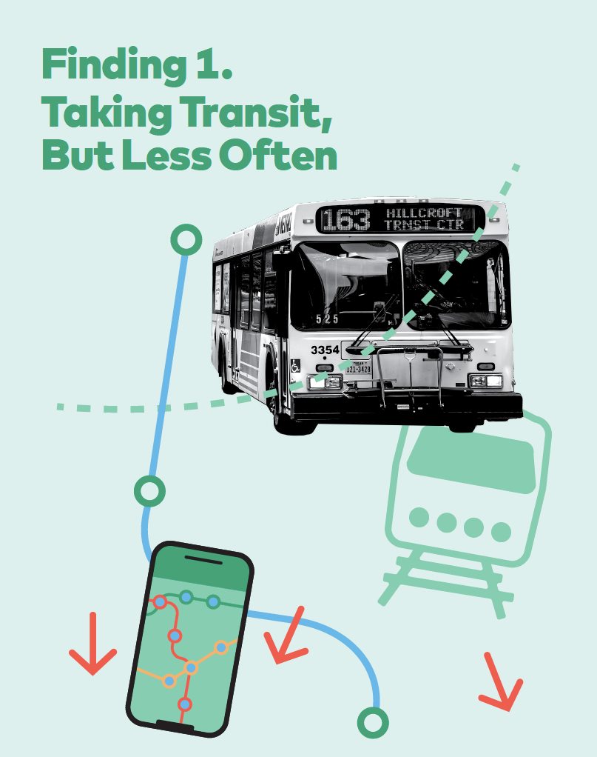
Find our work at:
www.transitcenter.org
@TransitCenter
Notes:
We’re going to launch next week! Here’s the cover and some illustrations from the report.
We’ve already received very positive feedback on the report from our peer reviewers, a group that included academics, transit agency staff, and planner consultants.

Slide 3
Using data to Re
Follow Our Regular Blog Posts

Slide 4
Our guiding belief: Making transit more frequent, reliable, fast and 18 hours a day 7 days a week – improving usefulness for current and potential riders – is most important

Slide 5
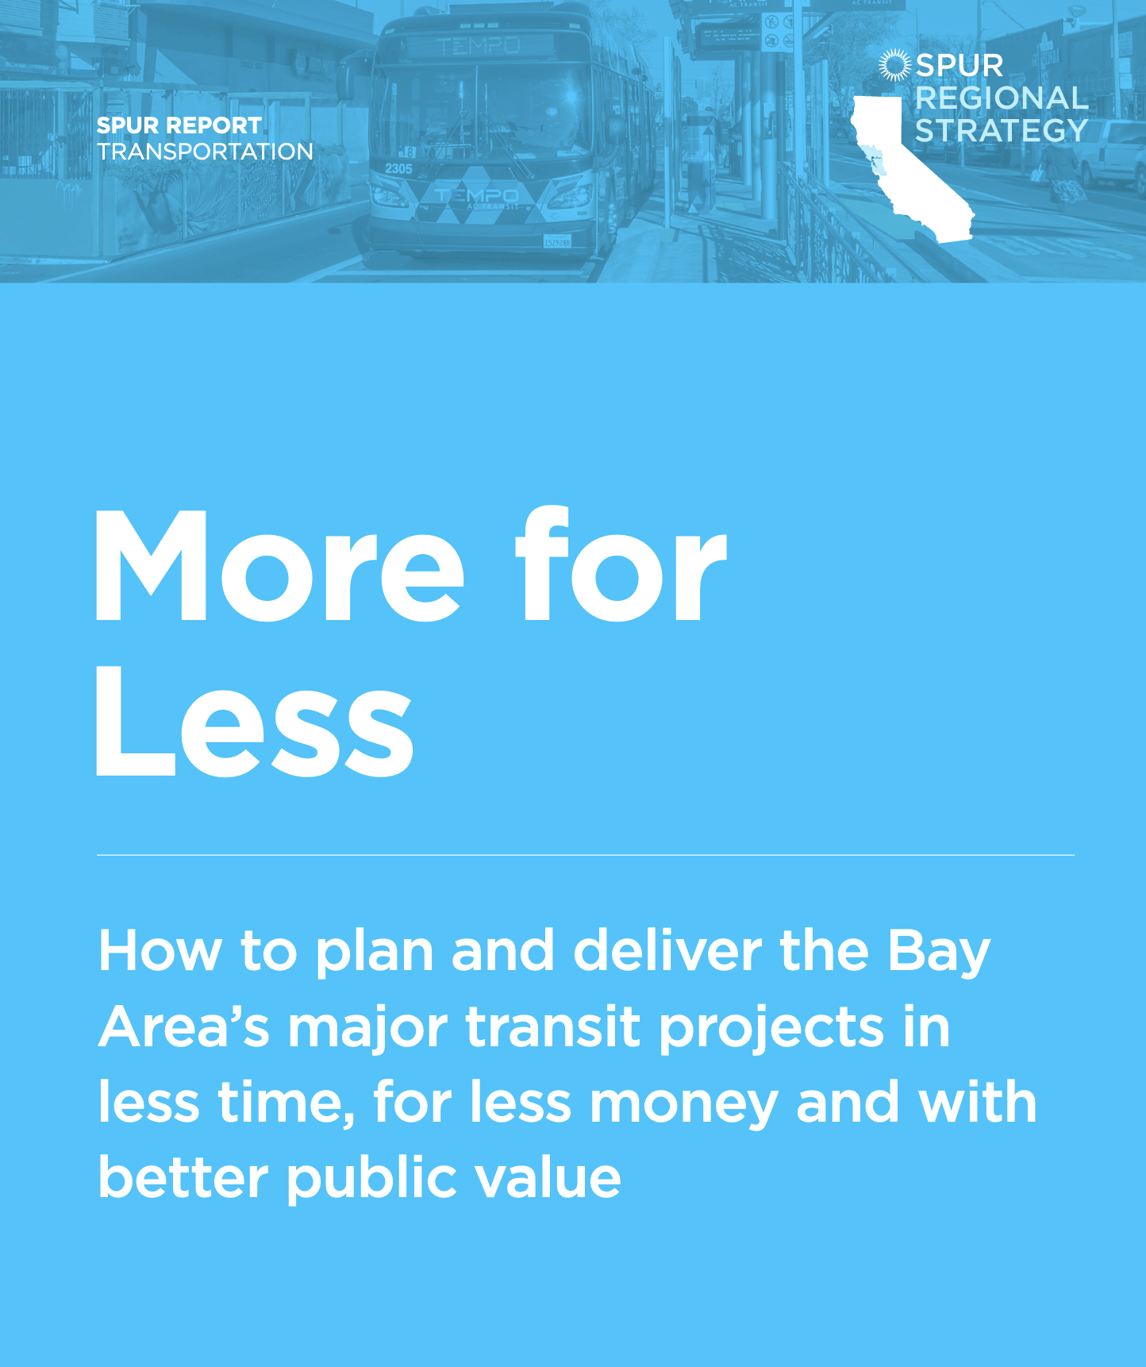
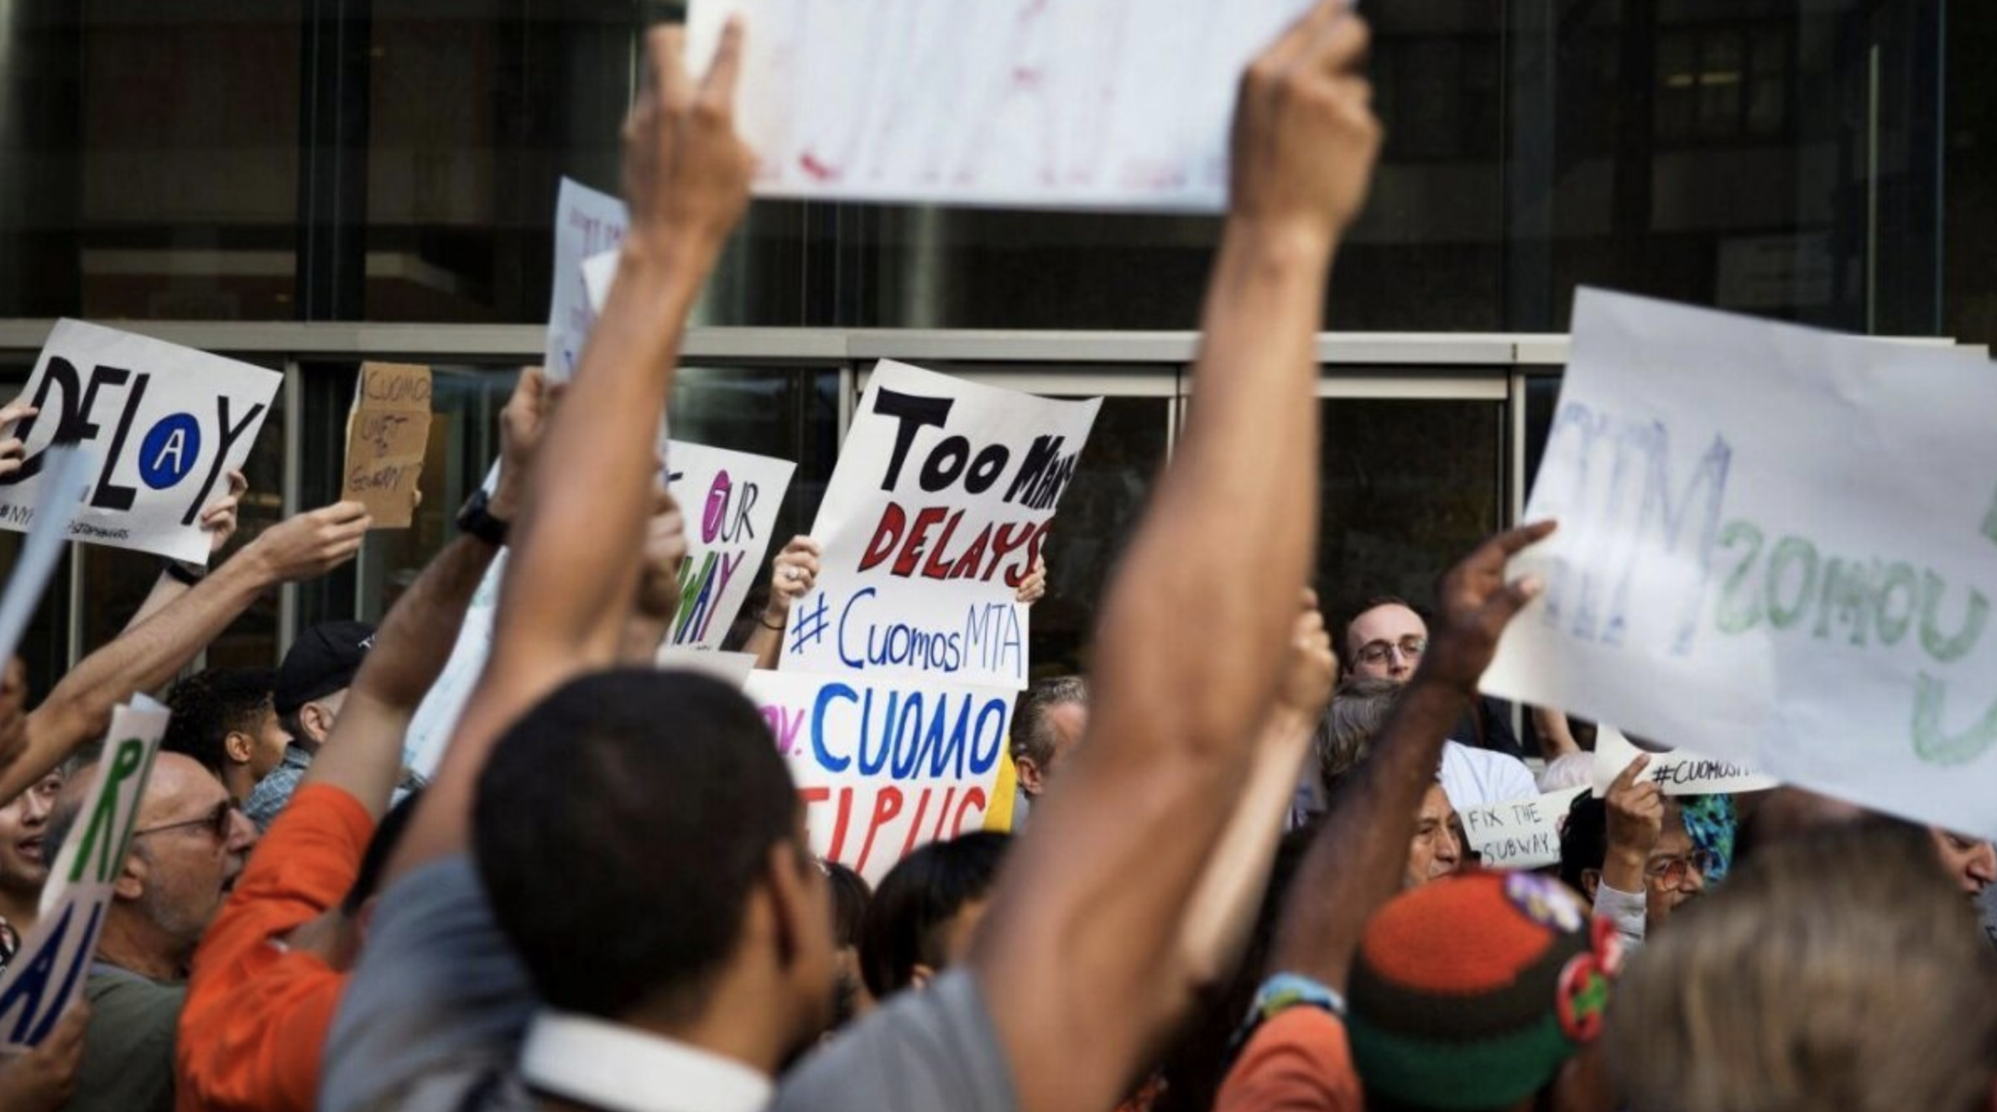
TransitCenter grants support both rider organizing for service improvements now, and technical advocacy for long-term policy change.

Slide 7
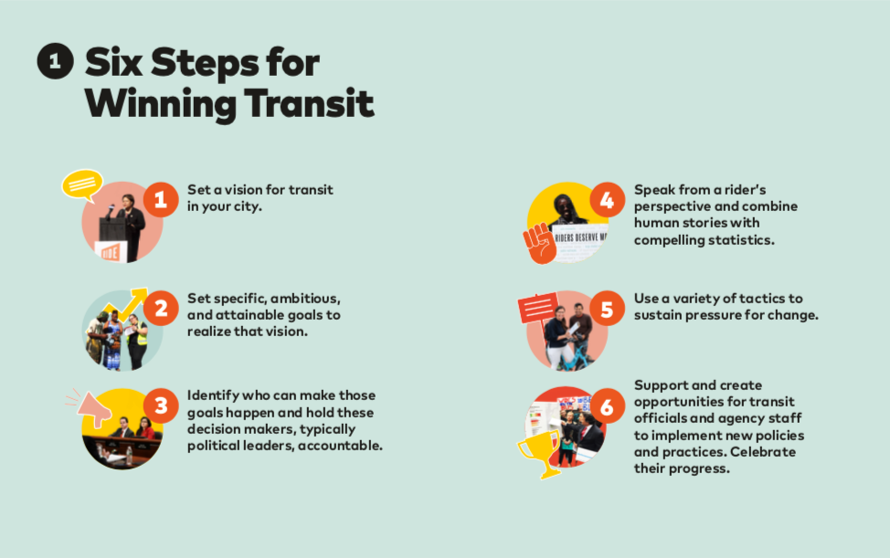

Slide 9
Current Riders Alone Are Not Enough To Win a Campaign
Austin Population: 957,807 people Votes cast in 2020 transit referendum: 414,961 voters Daily transit trips in 2019: 83,423 riders

Slide 10
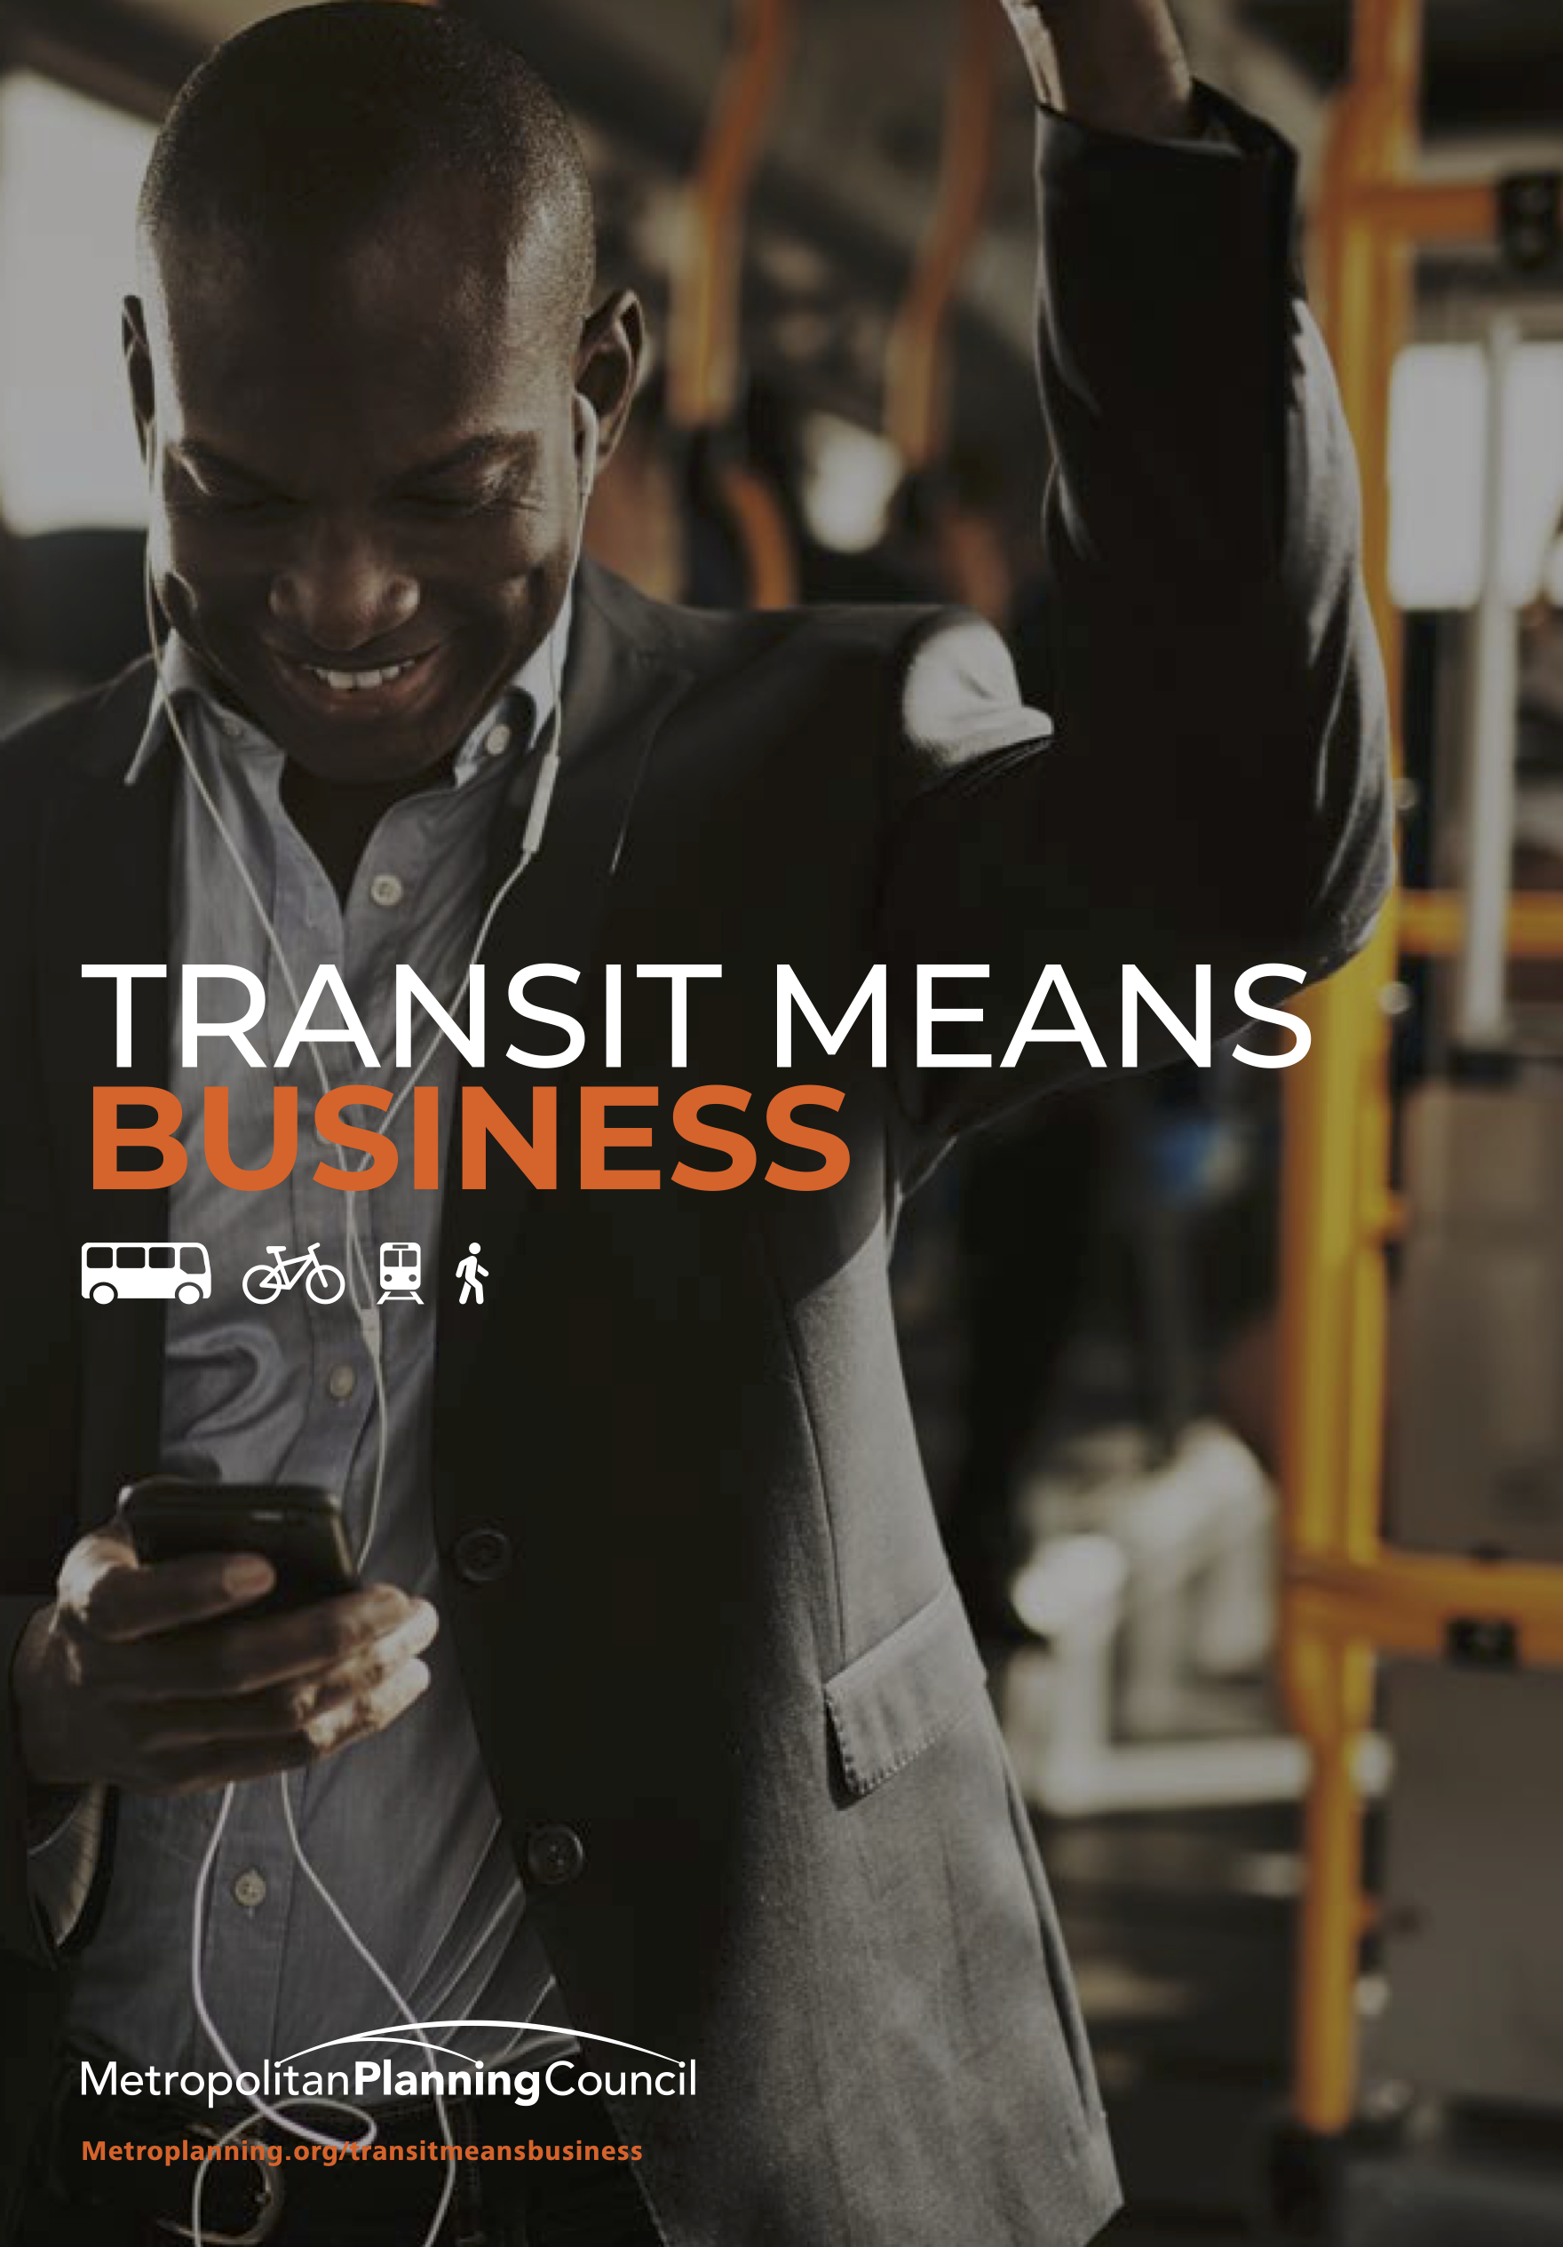
Broad Coalitions Win
Transit was included in COVID legislation due to diverse support from business, labor, environmentalists, et.al.
Successful ballot measures need support across political spectrum.
Big policy change like congestion pricing gets adopted only due to broad coalition.

Slide 11
Advocating with plain language, about practical benefits that every member of society can picture, wins more victories than pleading for a service perceived as only a social safety net service. “Targeted universalism” strategy uses language that vast majorities of the public relate to, while implementation focuses on those who use the service most.

Slide 12
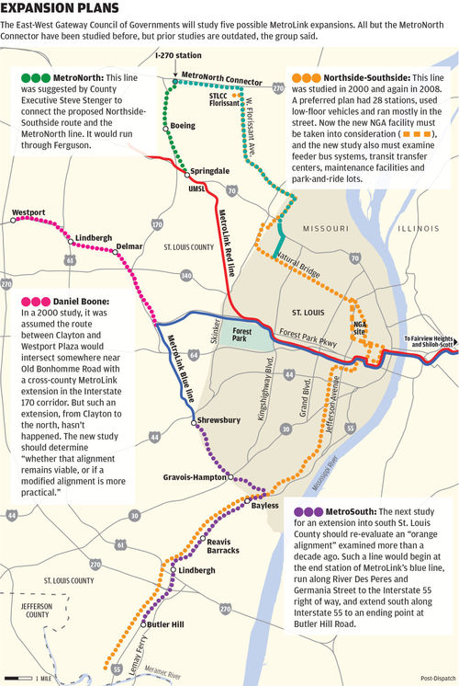
This map
doesn’t tell
us much
about
usefulness –
because it doesn’t
depict frequency.
St. Louis Post-Dispatch, Aug 1, 2016.
@shigashide

Slide 13
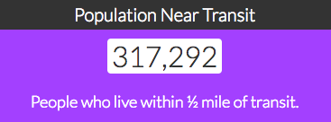
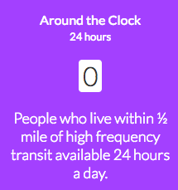
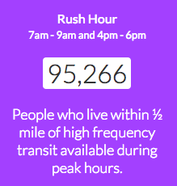
Frequency and connectivity are most important - and must be depicted in terms of “access” not lines
13
@TransitCenter
All-Transit, alltransit.cnt.org
13
13
@TransitCenter
Notes:
Not Dallas
Not exactly Denver
More like Houston
More like Seattle
Rah-rah about how it comes down to champions in three sectors
We’re here meeting with electeds and advocates to work on those ends; it’s up to you on this end.

Slide 14
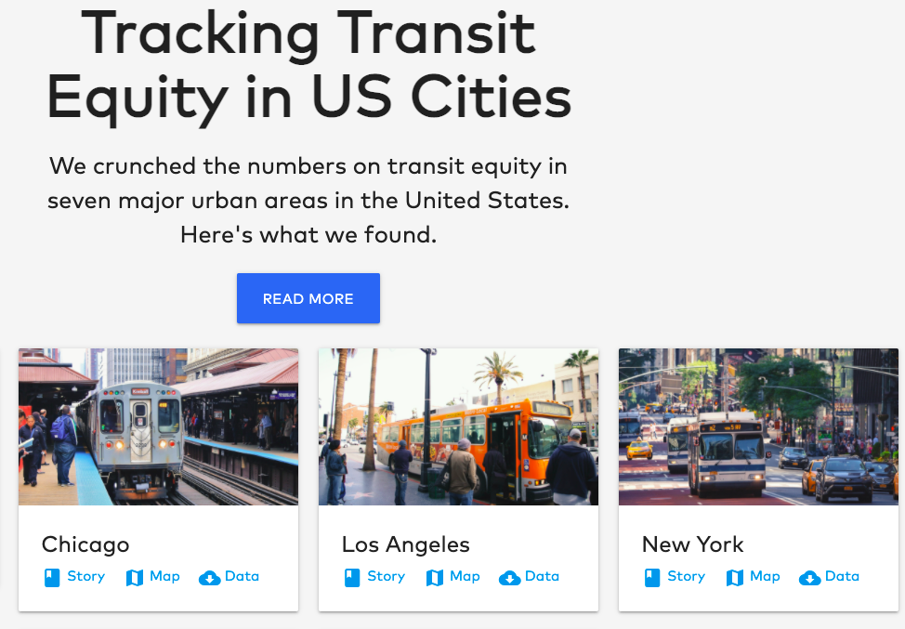
TransitCenter’s Equity Dashboard
Our aims:
Assess outcomes for entire network
Focus on outcomes for riders, not jurisdictions
Demonstrate people’s ability to access a variety of needs, disaggregated by race, income, demographics

Slide 15
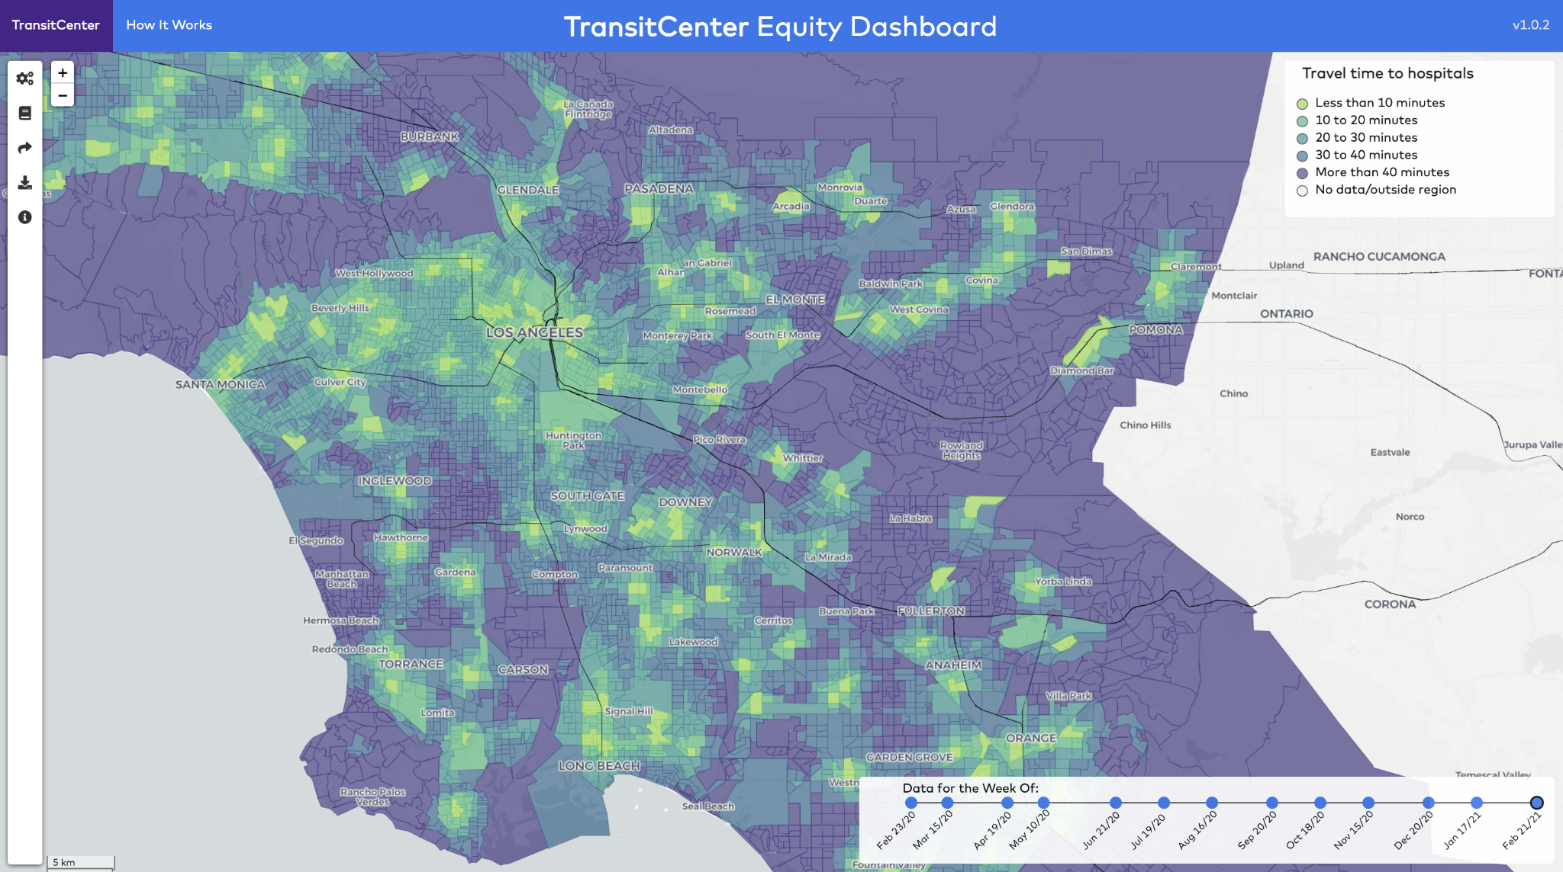
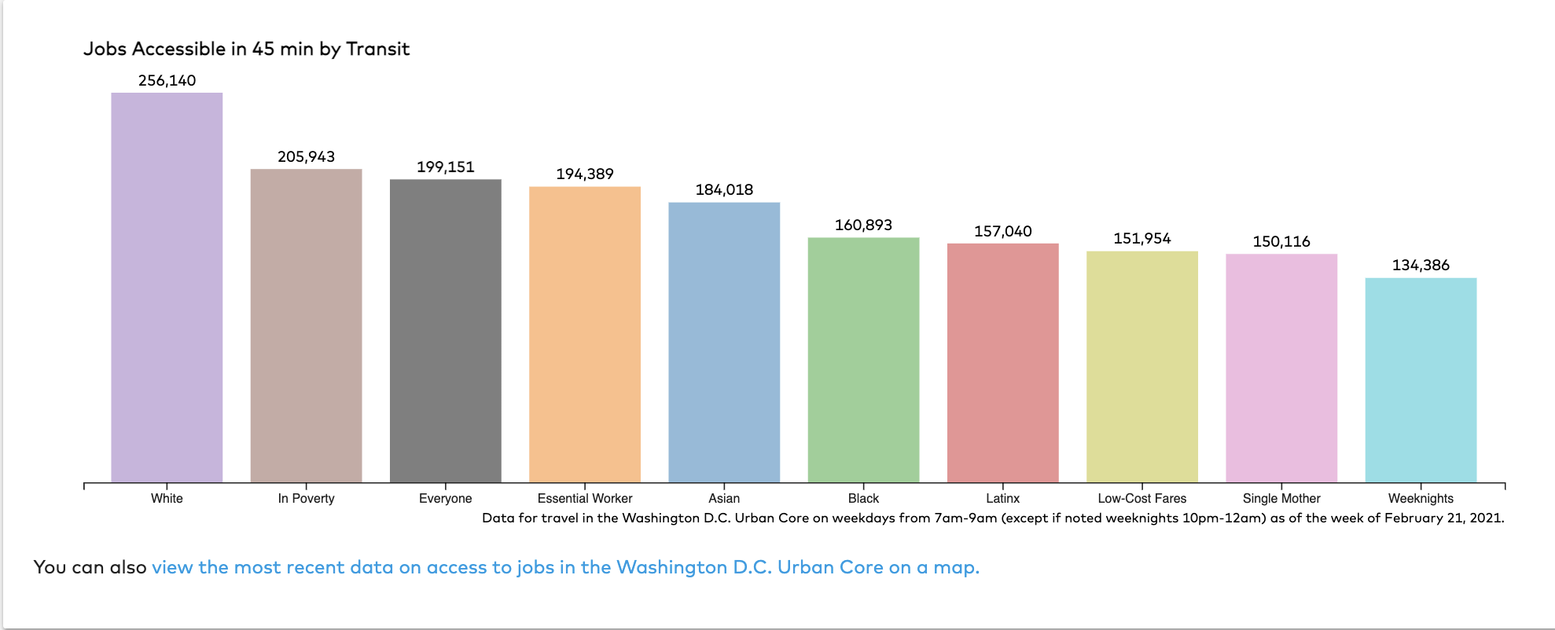
Dashboard goal: diagnose transportation inequities, then plan & provide service that alleviates those inequities
Dashboard: measures access to opportunity on public transit
E.g. how many jobs can the average Black resident of D.C. get to in 45 min?
How long is the transit trip to the nearest grocery store from my home?
Notes:
High-level project goal of the project
Basic introduction to access to opportunity measures (what format can they take?) & why they are valuable (get at experience + outcomes, link land use + transpo)

Slide 16
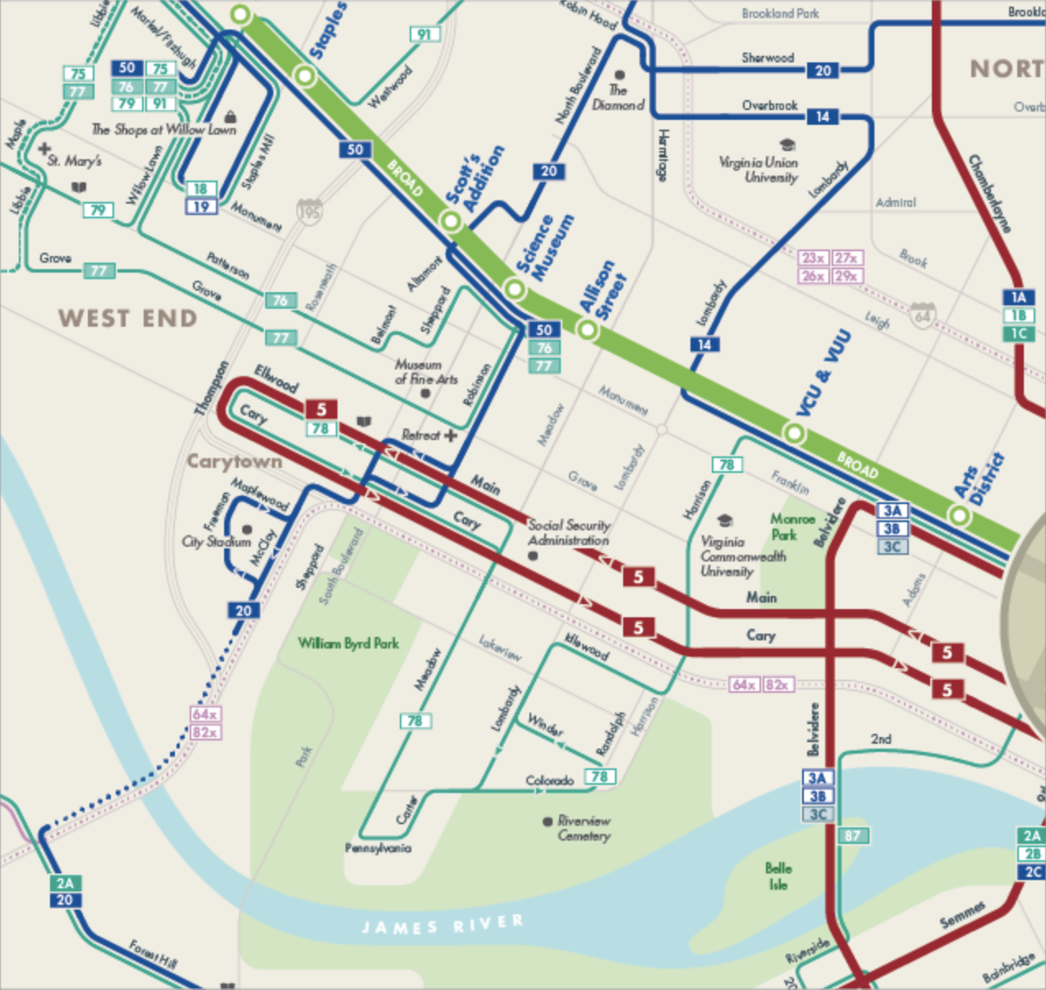
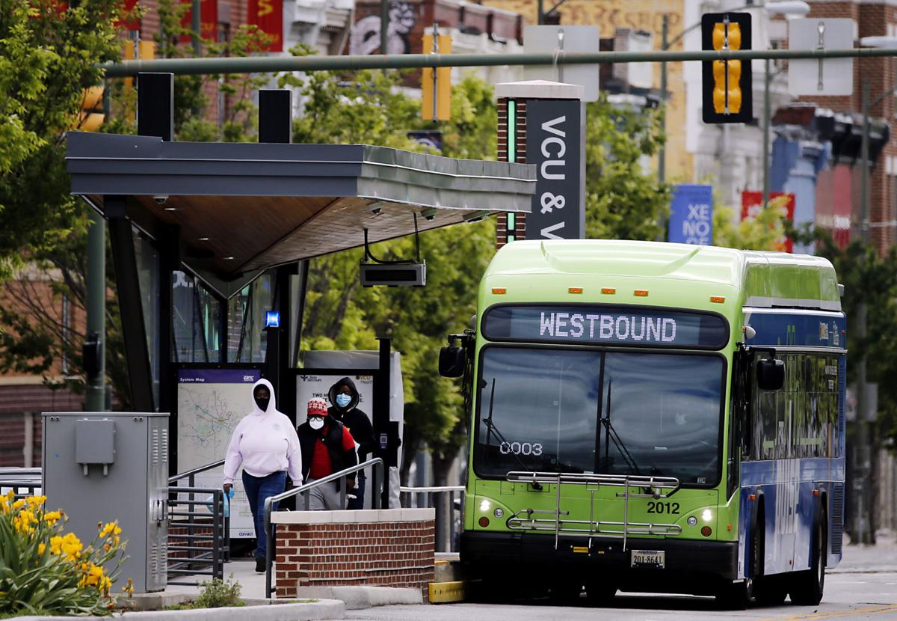
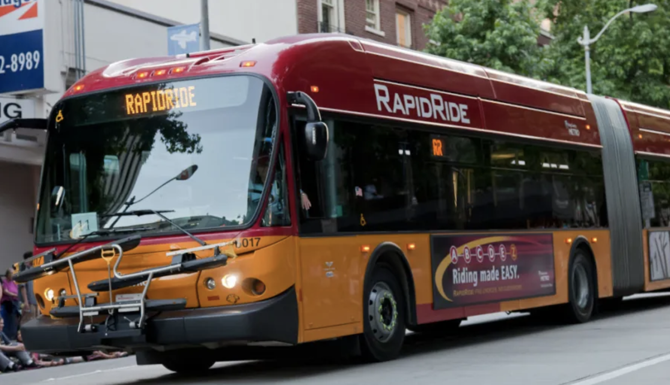
Win better transit, with a broad coalition and message – and clear intention of practical outcomes and benefits
Growing More Ridership is the Key to Transit’s Societal Impact: Whether Equity, Environmental or Economic.
Growing More Ridership Requires Intentional Focus on Fundamentals

Slide 17
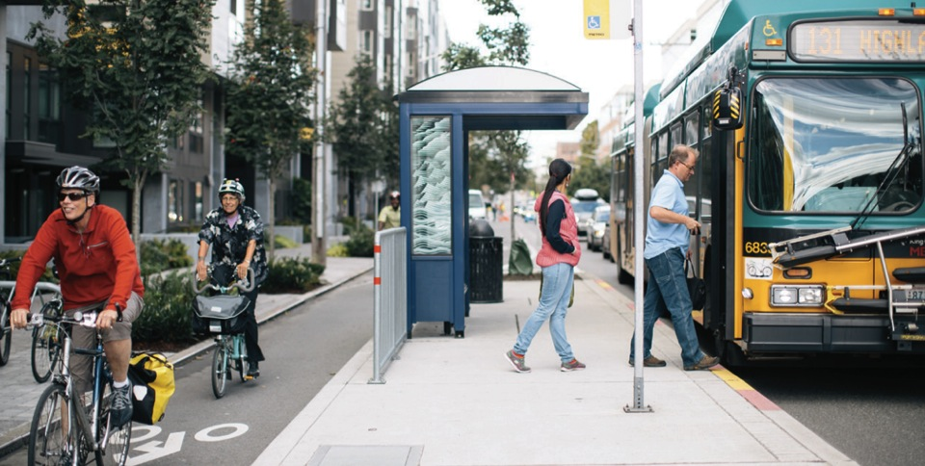
David Bragdon | dbragdon@transitcenter.org
@TransitCenter

