Slide 1
APTA Transit Initiatives & Communities Conference 2022
Passing Issue 7

Slide 2
SUCCESSFUL PASSAGE OF ISSUE 7
Issue 7
A Success!

Slide 3
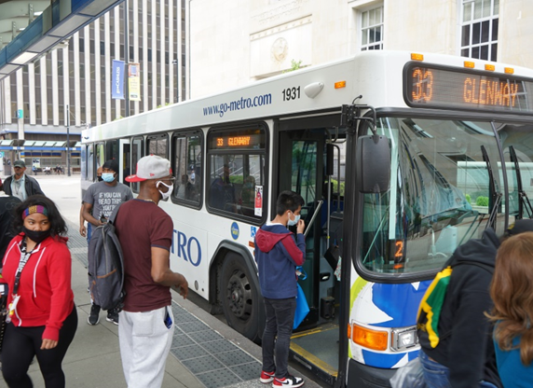
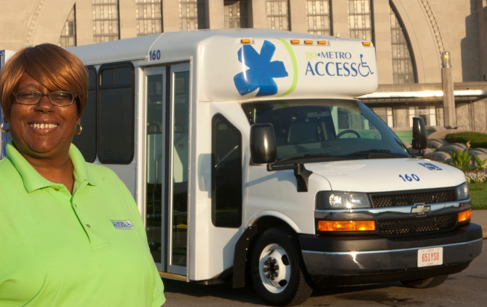
WHO WE ARE
The Southwest Ohio Regional Transit Authority (SORTA)/Metro:
Provides 13.5M passenger trips annually
Serves Greater Cincinnati and Hamilton County with commuter service to Warren, Clermont and Butler Counties
Operates Access paratransit service

Slide 4
MAKING THE BUSINESS CASE
Increasing costs related to aging fleet & declining infrastructure
Projected nearly $185M deficit over the next 10 years
Facing route eliminations, decrease in frequency and more people unable to access jobs
Needed to move from City income tax funding base to county sales tax funding model

Slide 5
HURDLES TO OVERCOME
Voters weary of streetcar
Three previous failed levies
Increase would make sales tax second highest in state at 7.8%

Slide 6
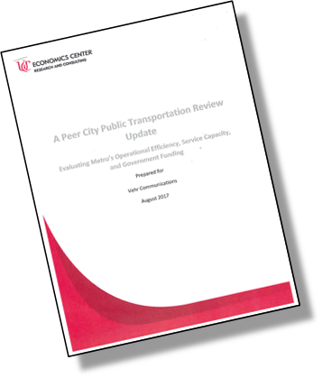
DEVELOPING THE PLAN
In 2015, awareness campaign launched:
Convened Metro Future Task Force
Significant input from:
Transportation and development consultants
University of Cincinnati Economic Center analysis
Surveys, focus groups, telephone research

Slide 7
MAKING THE BUSINESS CASE
#1 in operational efficiency among peers, but near the bottom in public funding received
Robust transit is key for economic competitiveness to attract major employers & retain talent
EY comprehensive review commissioned by Cincinnati Chamber & CBC found that we are well managed, performs well when bench marked against peers and funding challenges are very real

Slide 8
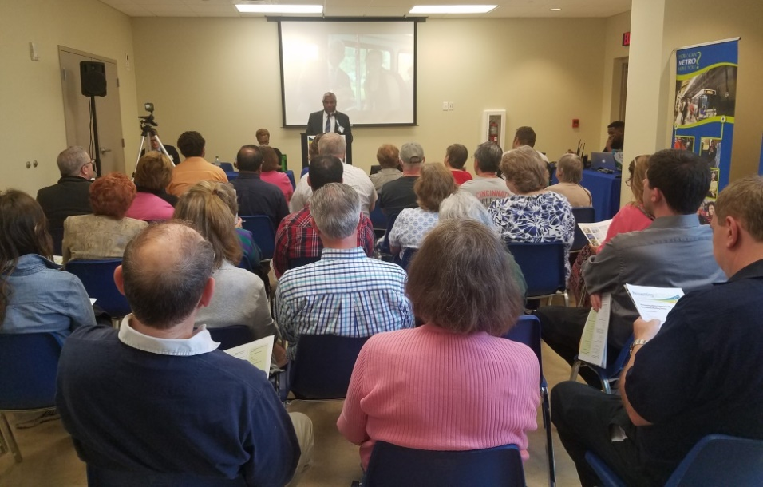
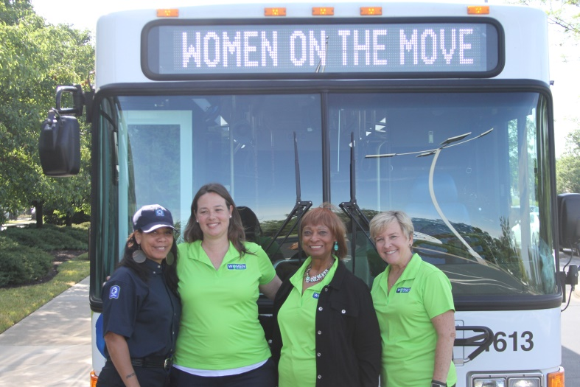
COMMUNITY ENGAGEMENT
Call-to-action: request presentations, provide feedback and email addresses for e-newsletter database
300+ community meetings and events:
Met with all 52 municipalities
Meetings with local and state elected officials
Community Coffee chats with CEO
Presentations & listening sessions with civic organizations, churches, seniors, disability advocates and other social/cultural groups

Slide 9
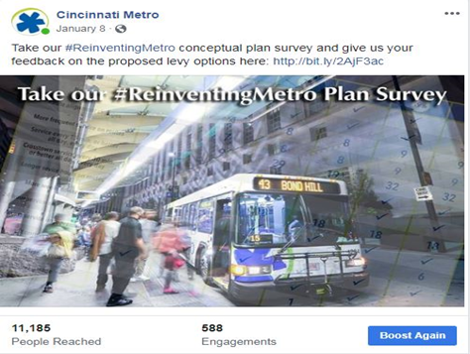
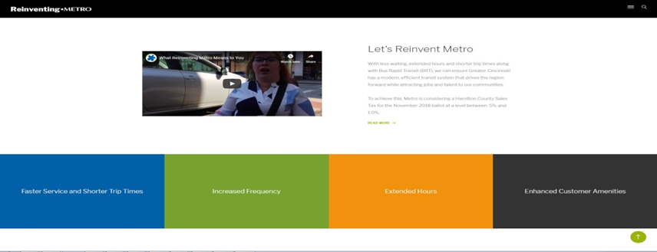
DIGITAL PRESENCE
Established ReinventingMetro.com website as source for latest info
Launched social media campaign using #ReinventingMetro
Created customer video testimonials
Brochures, infographics, direct mailer to 150K residents, leave behinds, etc.

Slide 10
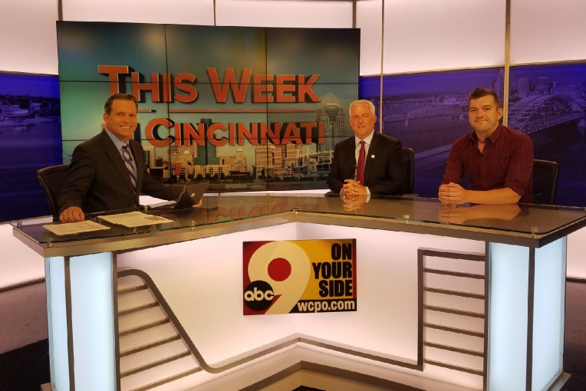
MEDIA
Robust public relations efforts:
Public affairs circuit
Op-Eds
Editorial board meetings
Guest column features

Slide 11
VOTER PERSONAS

Slide 12
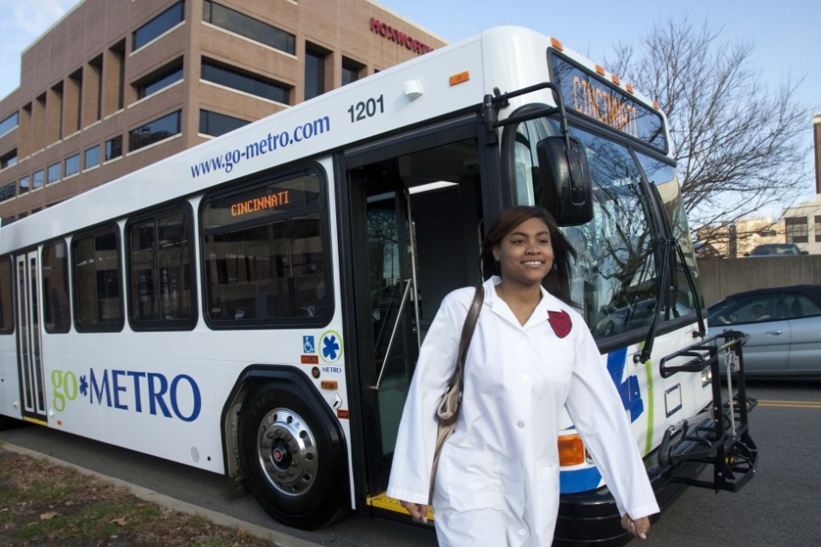
JOB ACCESS IMPROVEMENTS
20,000
More jobs accessible by Metro
740
More employers accessible by Metro
$850 Million
Total wages accessible by Metro

Slide 13
TRANSIT INFRASTRUCTURE FUND
13
Transit Infrastructure Fund
25 percent (approx. $30M annually) of the proceeds of the levy are to be used towards infrastructure projects in Hamilton County.
Projects may include building or maintaining roads and bridges, etc.
Must be within service area that Metro buses operates

Slide 14
EVERYBODY RIDES METRO FOUNDATION
The Everybody Rides Metro Foundation (Empowerment Fund) to support low-income riders with $500K annually by reimbursing social service agency partners 50% of fare for travel for trips related to:
Work and job training
Medical services
Social services

Slide 15
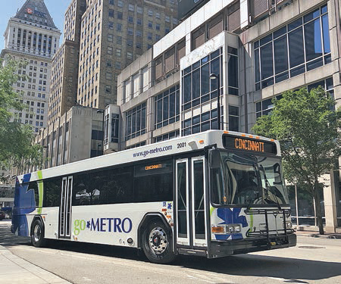
THE WINNING COMBINATION
.08% Hamilton County Sales Tax for 25 years
Something for riders and non-riders in plan
Ballot language specified that no funds to be used for streetcar
Broad bipartisan support: union, elected officials, social services, business community, faith leaders, etc.
Strong coalition of advocates
PAC, Move Forward Hamilton County, endorsement list included more than 30 local orgs. and 40 elected officials
No organized opposition
15

Slide 16
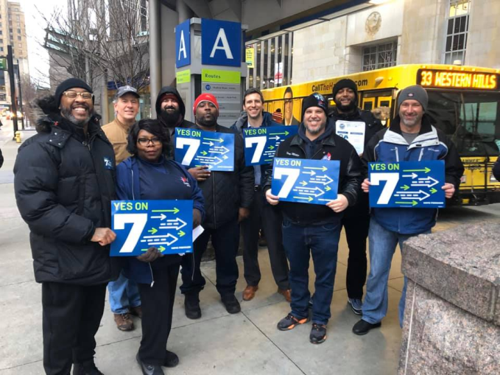
COUNT DOWN TO THE ELECTION
Oct 2015: Awareness campaign began
Apr 2018: Rolled out The Plan
Sept 2019: Board approves levy
Sept 2019: Move Forward PAC formed
Nov 2019: Voters approved Issue 22 to rollback 0.3% city earnings tax if Issue 7 passes
Mar 2020: Election delayed by COVID-19
May 2020: Issue 7 passes by 980 votes
16

Slide 17
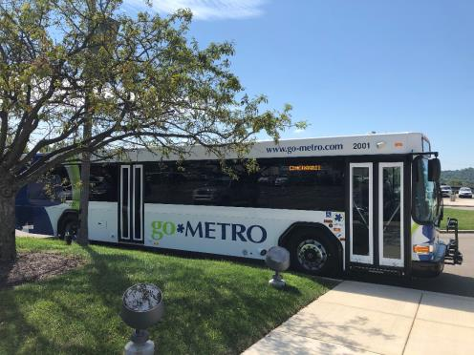
ADDITIONAL QUESTIONS? CONTACT ME
THANK YOU!
Brandy Jones, APR
SVP, External Affairs
Bjones@go-metro.com
@Mrsbrandyjones
@CincinnatiMetro

