Slide 8
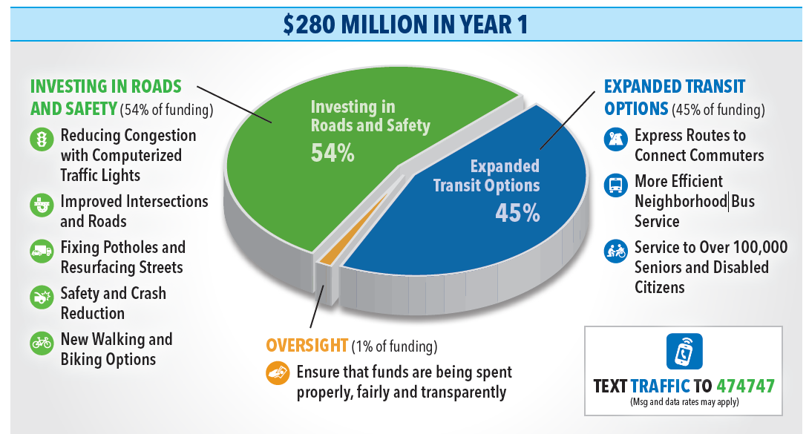

Slide 9
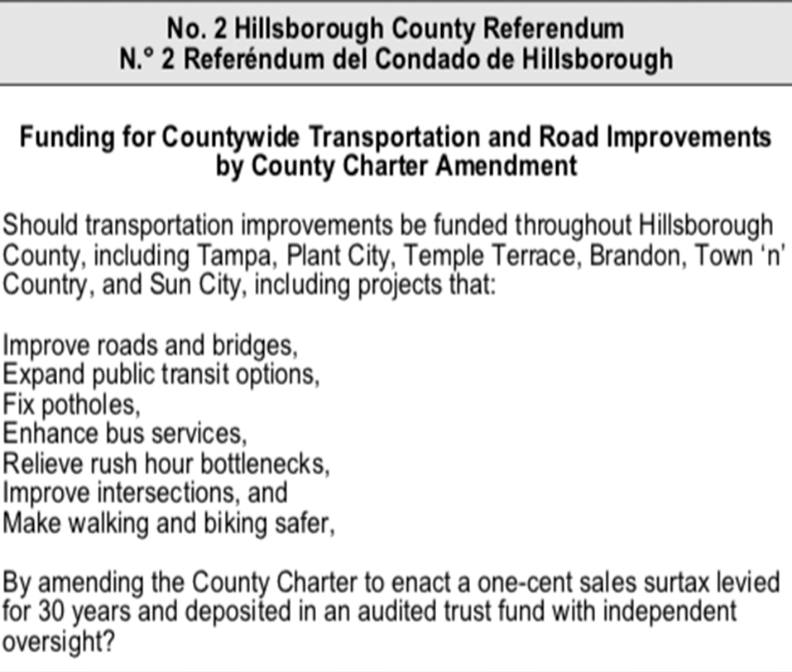

Slide 11
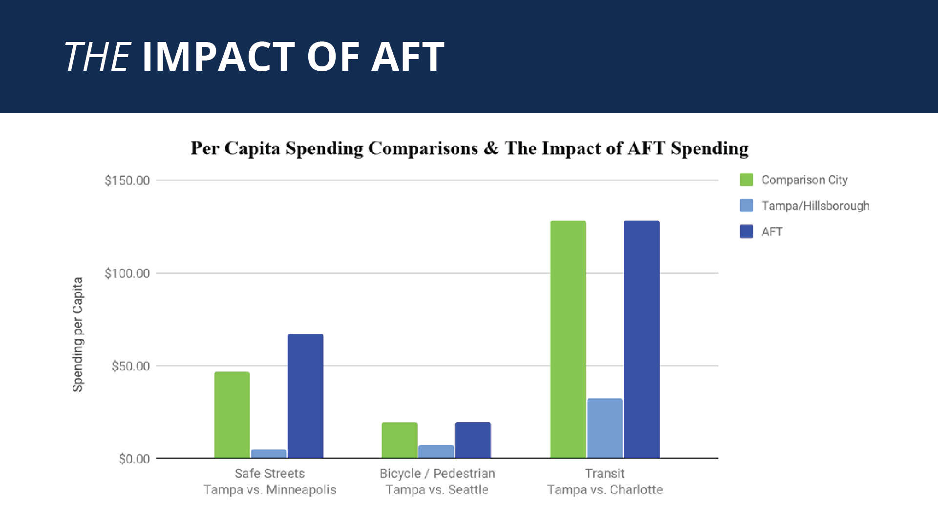
Sources: Bicycling and Walking in the United States Benchmarking report, 2018, Minneapolis City Budget, National Transit Database

Slide 14
Notes:
Talking points:
You can be successful setting out a specific list of projects and promoting where every dollar will be spent but you can also be successful setting out priorities and a vision without as much detail.
Safety, better transit, more job access, ect.
In our case, too much detail had not worked for us.
Communities that do not have robust transit (in our case, our transit spending is the same as Macon GA) you need to set out a vision and not get stuck on specifics
Fundraise from the business community
Talking Points:
Grassroots fundraising is not the same for issue campaigns as it is for candidates
Do not waste time on small dollar donations
You are asking residents to pay more in taxes – that is their contribution!
Focus on the business community – big employers, transportation companies, healthcare partners – to raise funds for a campaign.
Start at an appropriate time
Talking Points:
Voters are not paying attention too early
Community engagement by the agency happens as the plan comes into focus but an advocacy effort does not need to be a year long. Focus on the August through November for a general election ballot
Starting too early invites opposition and allows time to get organized
Do not engage your opposition
Talking Points:
No plan is not a valid argument
Do not debate or lend credibility to those who argue doing nothing or kicking the can down the road is a valid solution

Slide 15
TAMPABAY.ORG
Facebook.com/All for Transportation
Twitter: @allfortransport

