Slide 1
Lessons Learned
in my career as an organizer, spitball shooter, policy wonk, political hack, communications consultant, climate anxiety-haver, and overall huge transit nerd
Aaron Brown
Oregon Transportation Futures Project

Slide 2
APTA - Transit Initiatives and Communities Workshop | July 20, 2022 | @ambrown | www.amb.fyi
Who is this guy anyway

Slide 3
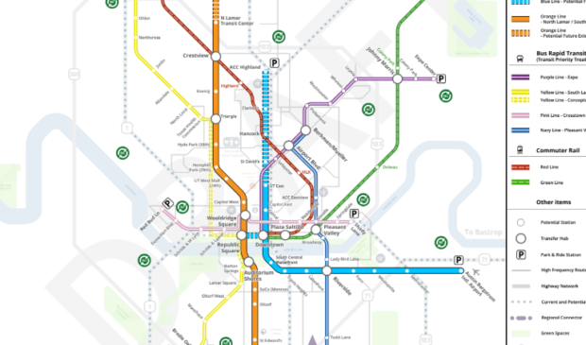
APTA - Transit Initiatives and Communities Workshop | July 20, 2022 | @ambrown | www.amb.fyi
All organizing is science fiction

Slide 4
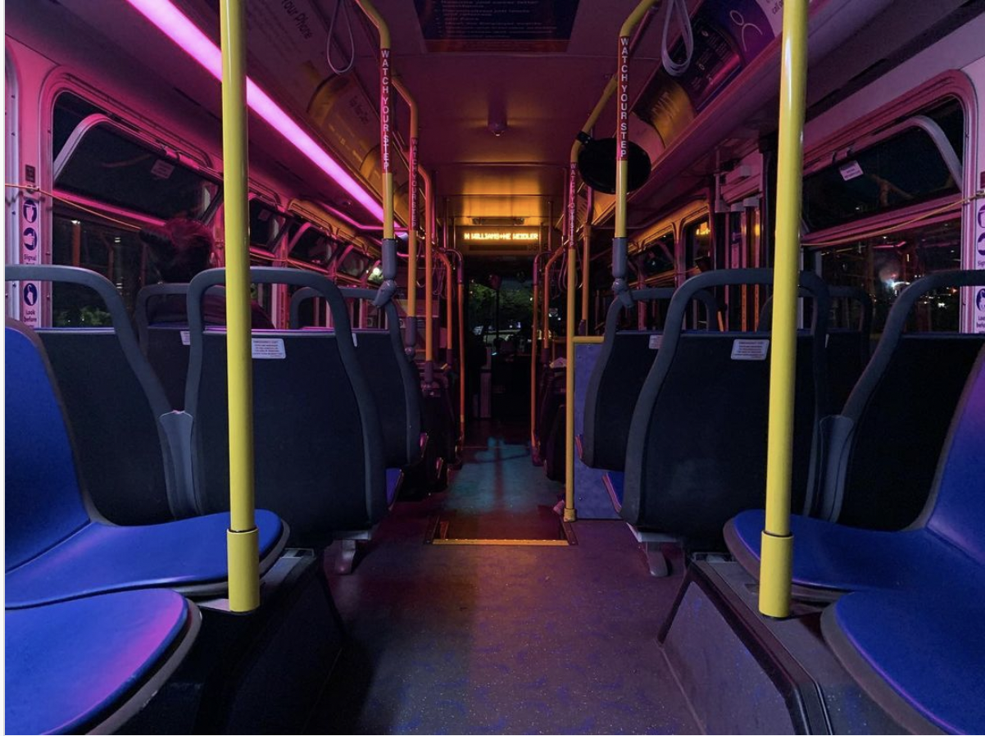
APTA - Transit Initiatives and Communities Workshop | July 20, 2022 | @ambrown | www.amb.fyi
Prioritize finding a way to live your values

Slide 5
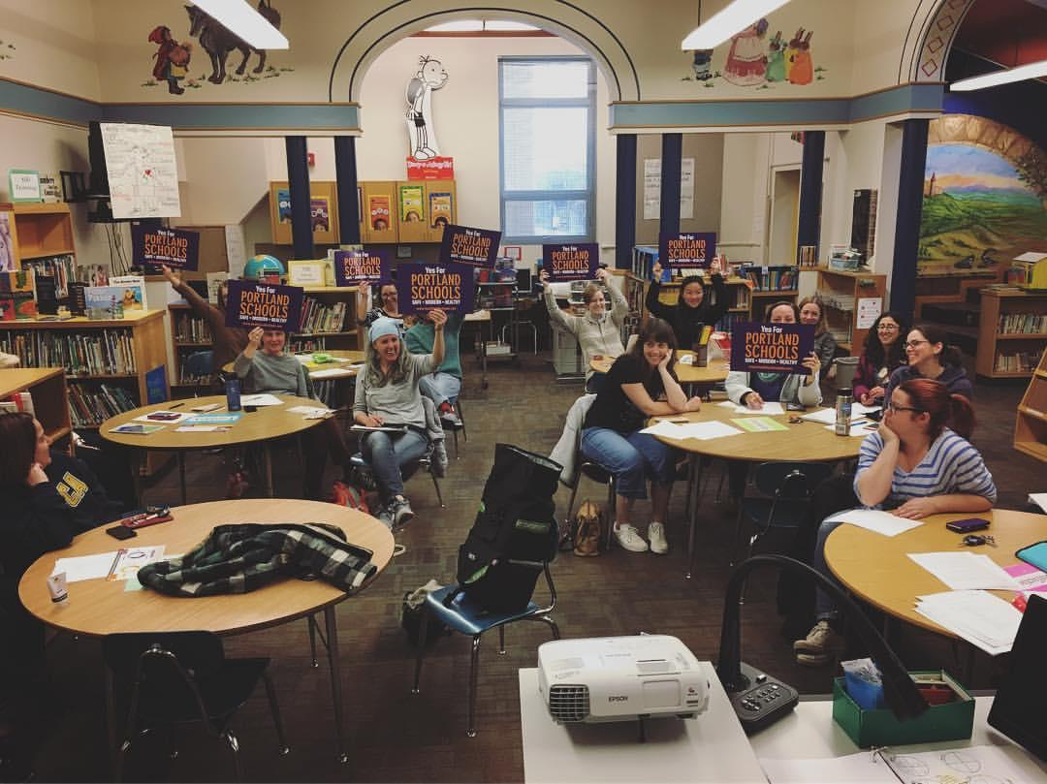
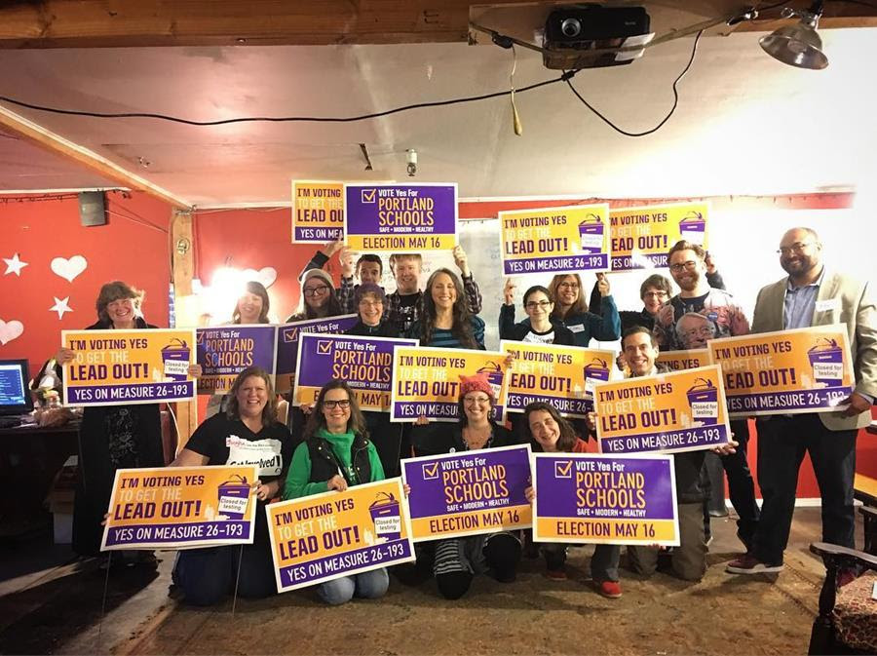
APTA - Transit Initiatives and Communities Workshop | July 20, 2022 | @ambrown | www.amb.fyi
Leverage and empower existing social institutions

Slide 6
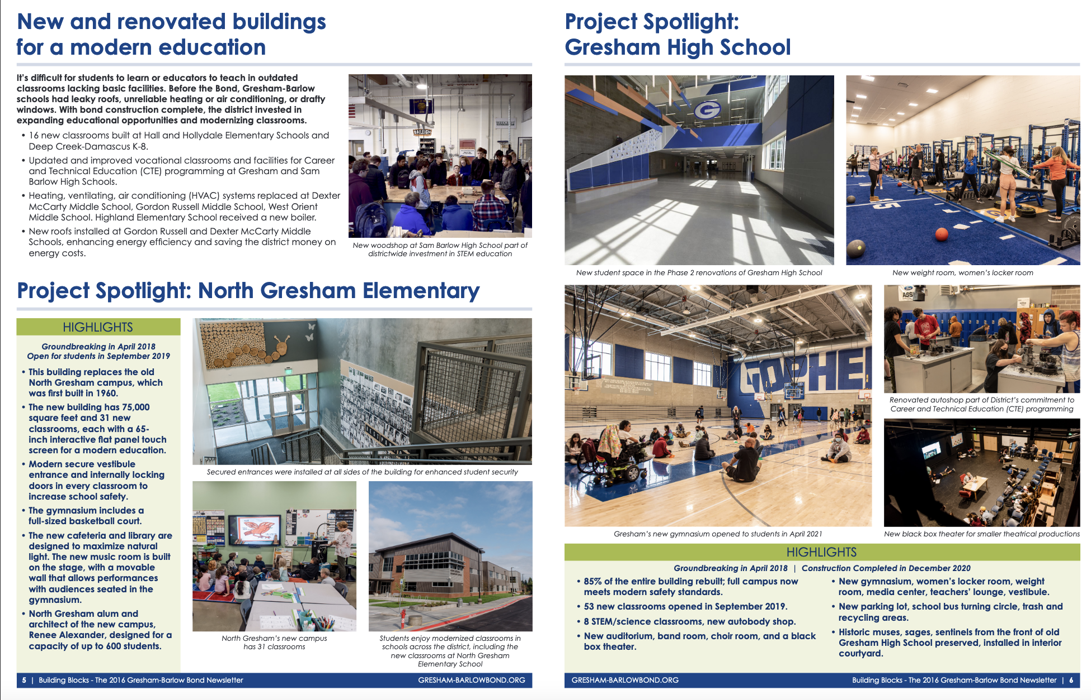
APTA - Transit Initiatives and Communities Workshop | July 20, 2022 | @ambrown | www.amb.fyi
Celebrate your victories - and make sure everyone’s invited to the party

Slide 7
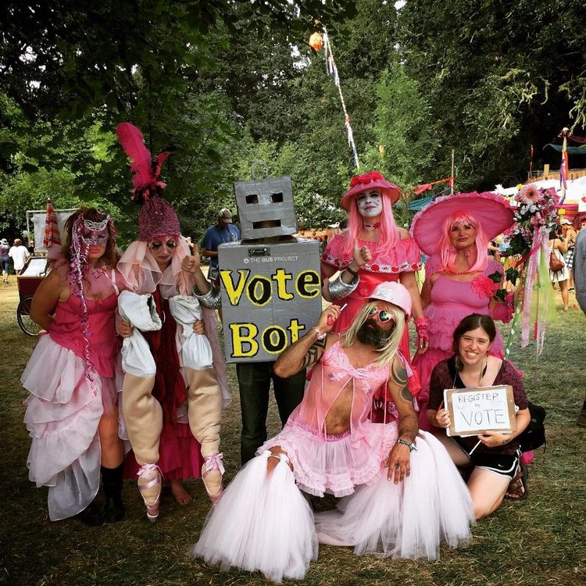
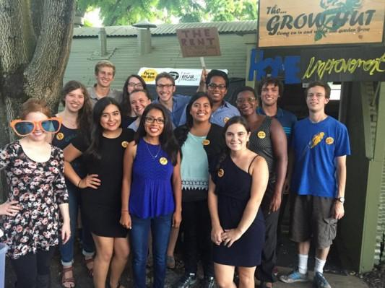
APTA - Transit Initiatives and Communities Workshop | July 20, 2022 | @ambrown | www.amb.fyi
…speaking of parties

Slide 8
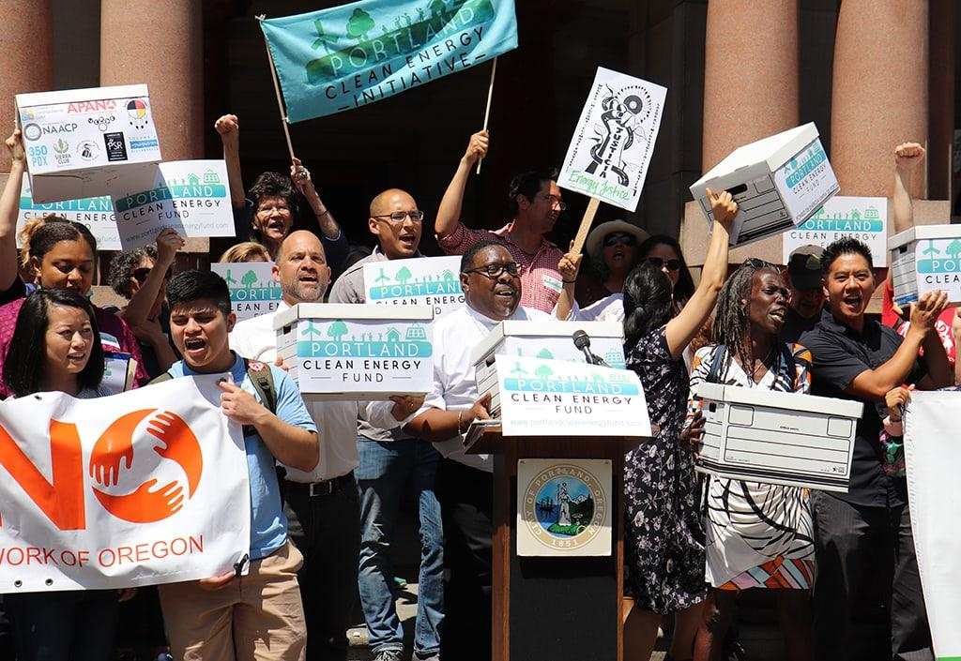
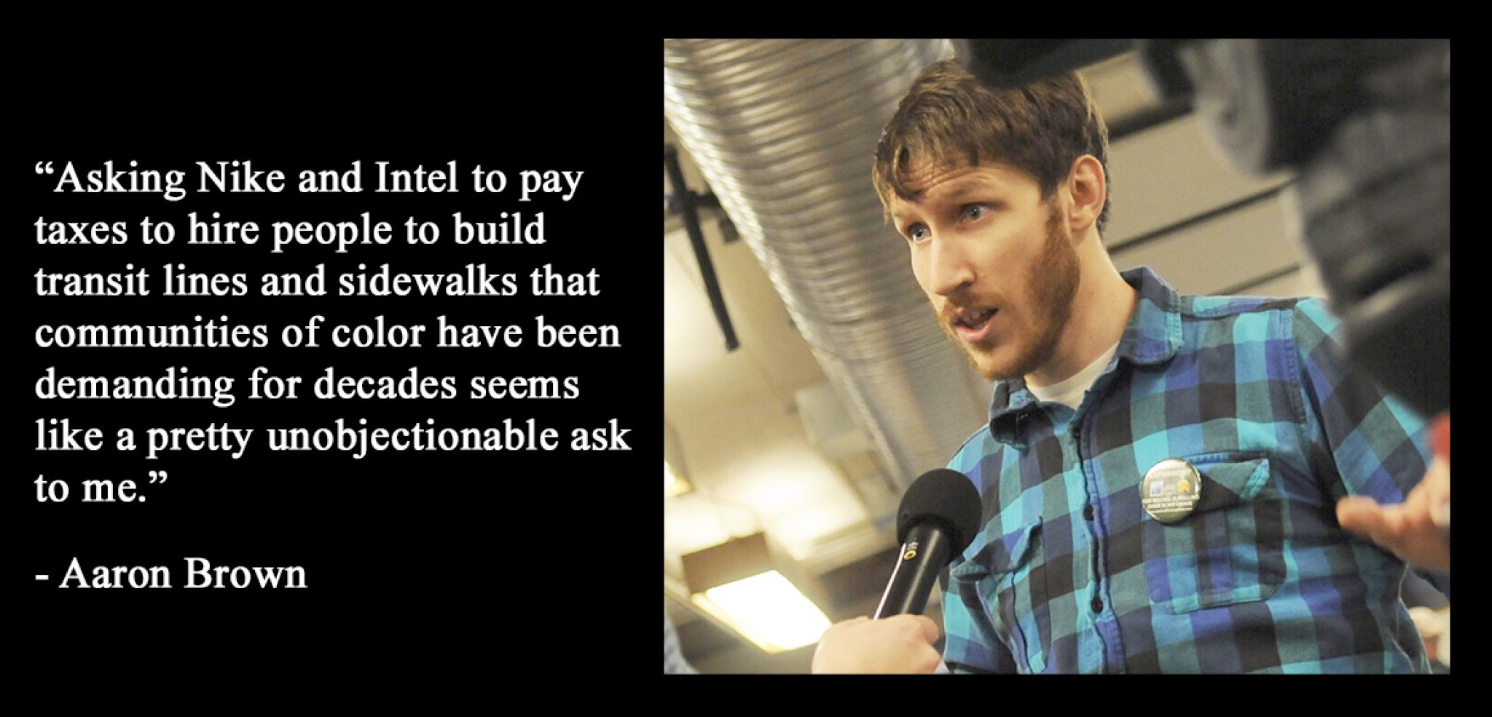
APTA - Transit Initiatives and Communities Workshop | July 20, 2022 | @ambrown | www.amb.fyi
Be candid, pragmatic, and realistic with power mapping

Slide 9
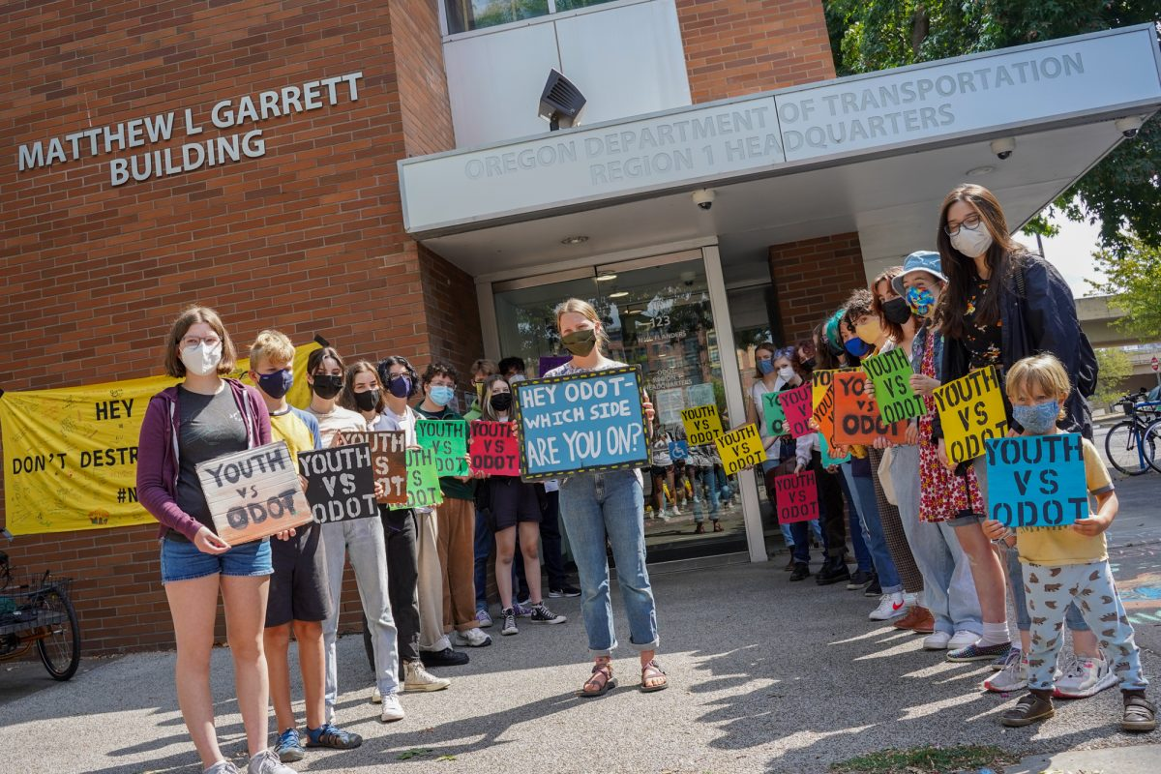
APTA - Transit Initiatives and Communities Workshop | July 20, 2022 | @ambrown | www.amb.fyi
An investment in the youth and mentorship pays massive dividends (even when they are a pain in the butt)

Slide 10
APTA - Transit Initiatives and Communities Workshop | July 20, 2022 | @ambrown | www.amb.fyi
Your poll results are malleable (over the next few years, not the next few months)

Slide 11
APTA - Transit Initiatives and Communities Workshop | July 20, 2022 | @ambrown | www.amb.fyi
Organize at the speed of trust

Slide 12
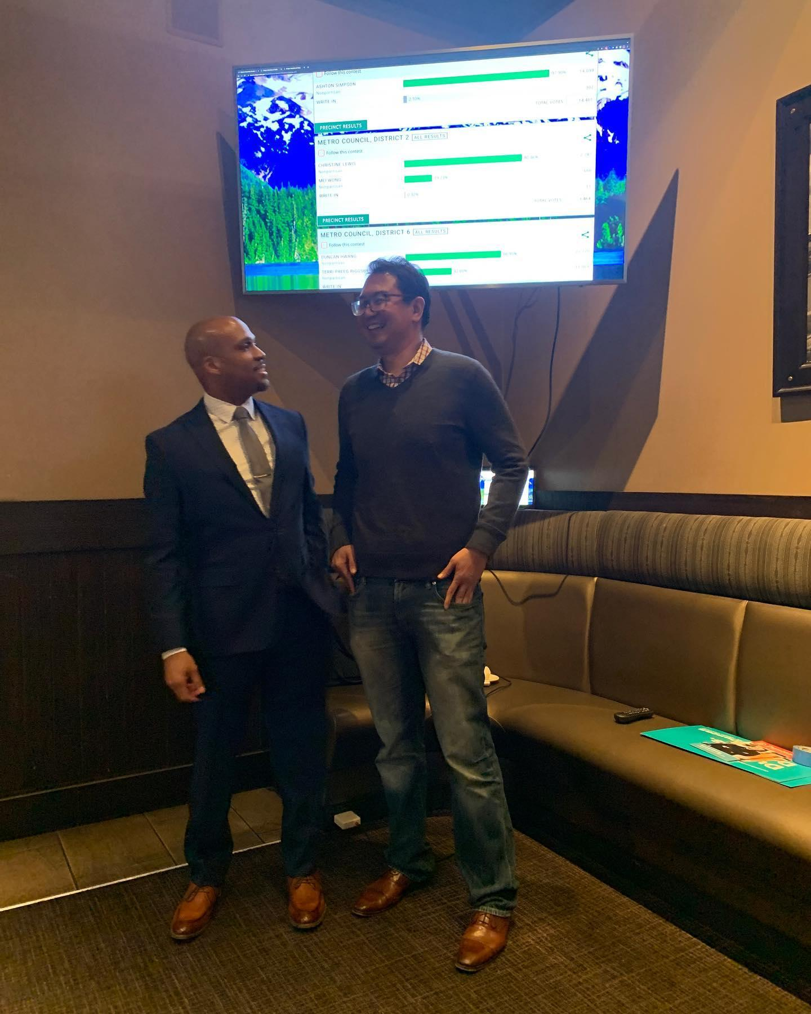
APTA - Transit Initiatives and Communities Workshop | July 20, 2022 | @ambrown | amb.fyi
Play the long game

